Slide 1

Therapeutic Recreation Ontario (TRO) Annual General Meeting 2022
Wednesday, June 22, 2022

Slide 2
2022 AGM Agenda
 | Agenda Item | Presenter | Time Allotted
1 | Call to Order and Confirmation of Quorum | Shannon McCallum | 12:00 – 12:05 PM (5 min)
2 | Approval of 2022 AGM Agenda | Shannon McCallum | 12:05 – 12:10 PM (5 min)
3 | Approval of 2021 AGM Minutes | Shannon McCallum | 12:10 – 12:15 PM (5 min)
4 | President’s Remarks | Shannon McCallum | 12: 15 – 12:25 PM (10 min)
5 | Introduction of the 2022-2023 Board of Directors | Shannon McCallum | 12: 25 – 12:35 PM (10 min)
6 | Financial Report | Sue Talmey | 12:35 – 12:40 PM (10 min)
7 | 2-1 Designation update | Sue Verrilli | 12:40 – 12:50 PM (10 min)
8 | Other Business and Question and Answer Segment | Shannon McCallum | 12:50 – 12:55 PM (5 min)
9 | TRO’s Annual Report (Video) | Melissa Enmore | 12:55 – 12:59 PM (4 min)
10 | Adjournment of Meeting | Shannon McCallum | 12:59 – 1:00 PM (1 min)
Reminder: TRO’s members set the direction for the direction at the Annual General Meeting (AGM)

Slide 3
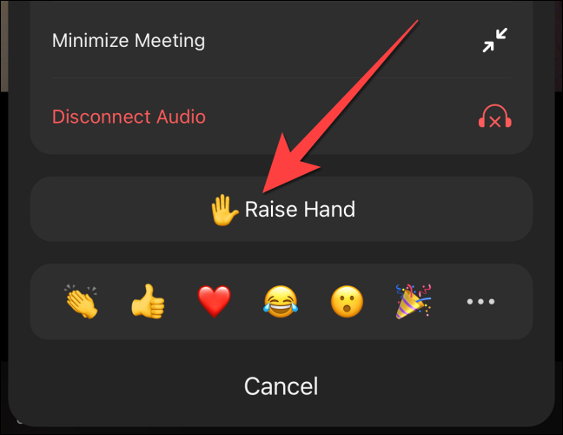
1. Call to Order and Confirmation of Quorum
AGM attendee to move the motion to call the meeting to order
AGM attendee to second the motion

Slide 4
2. Approval of the 2022 AGM Agenda
AGM attendee to move the motion to approve the agenda
AGM attendee to second the motion

Slide 5
3. Approval of the 2021 AGM Minutes
AGM attendee to move the motion to approve the 2021 AGM minutes
AGM attendee to second the motion

Slide 6
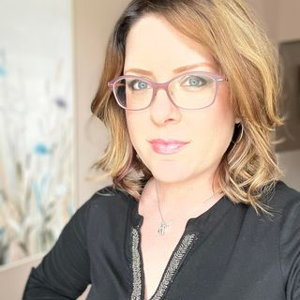
4. President’s Remarks
Shannon McCallum, R/TRO
TRO’s Board President 2021/2022

Slide 7
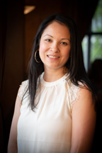

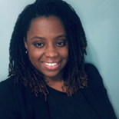
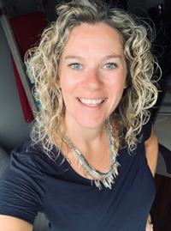
5. Introduction of the 2022-2023 Board of Directors
- Executive Committee Members
TRO’s 2022-2023 Board of Directors
TRO’s 2022-2023 Executive Committee Members
 | Name of Board Member | Board Position
1 | Katherine Lee, R/TRO | President-Elect
2 | Shannon McCallum, R/TRO | Past-President
3 | Debbie-Ann Fender | Vice President
4 | Katherine Plested | Secretary
Katherine Lee, R/TRO
Shannon McCallum, R/TRO
Debbie-Ann Fender, R/TRO
Katherine Plested, R/TRO

Slide 8
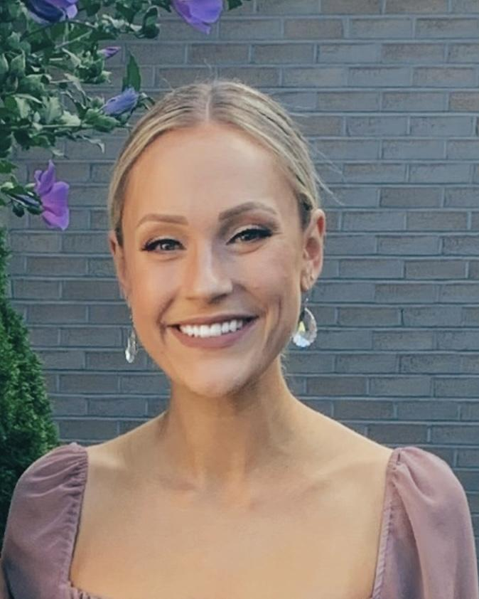
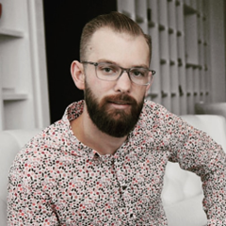
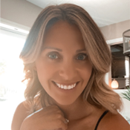
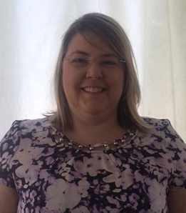
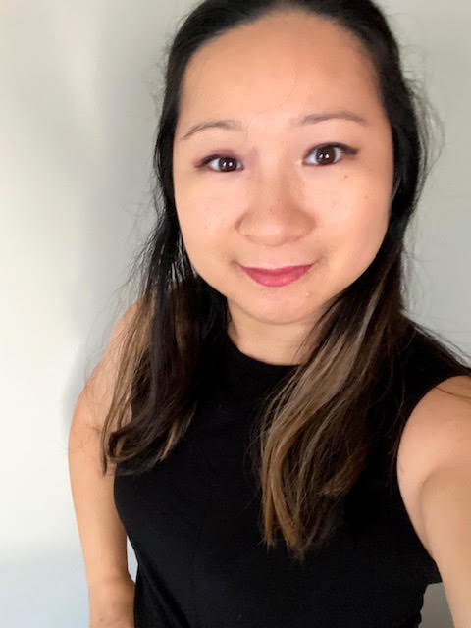
5. Introduction of the 2022-2023 Board of Directors
(Cont’d)
TRO’s 2022-2023 Board of Directors (cont’d)
 | Name of Board Member | Board Position | Year of Term
1 | Alexis More, R/TRO | Director-at-Large | 2nd Year of Term
2 | Blair Chard, R/TRO | Director-at-Large | 2nd Year of Term
3 | Jenna Davis, R/TRO | Director-at-Large | 2nd Year of Term
4 | Vicki Di Giovanni, R/TRO | Director-at-Large | 1st Year of Term (PRC)
5 | Yvonne Ng-Gerritsen, MA, CTRS, R/TRO | Director-at-Large | 1st Year of Term
Alexis More, R/TRO
Blair Chard,
R/TRO
Jenna Davis,
R/TRO
Vicki Di Giovanni, R/TRO
Yvonne Ng- Gerristen, MA, CTRS, R/TRO

Slide 9
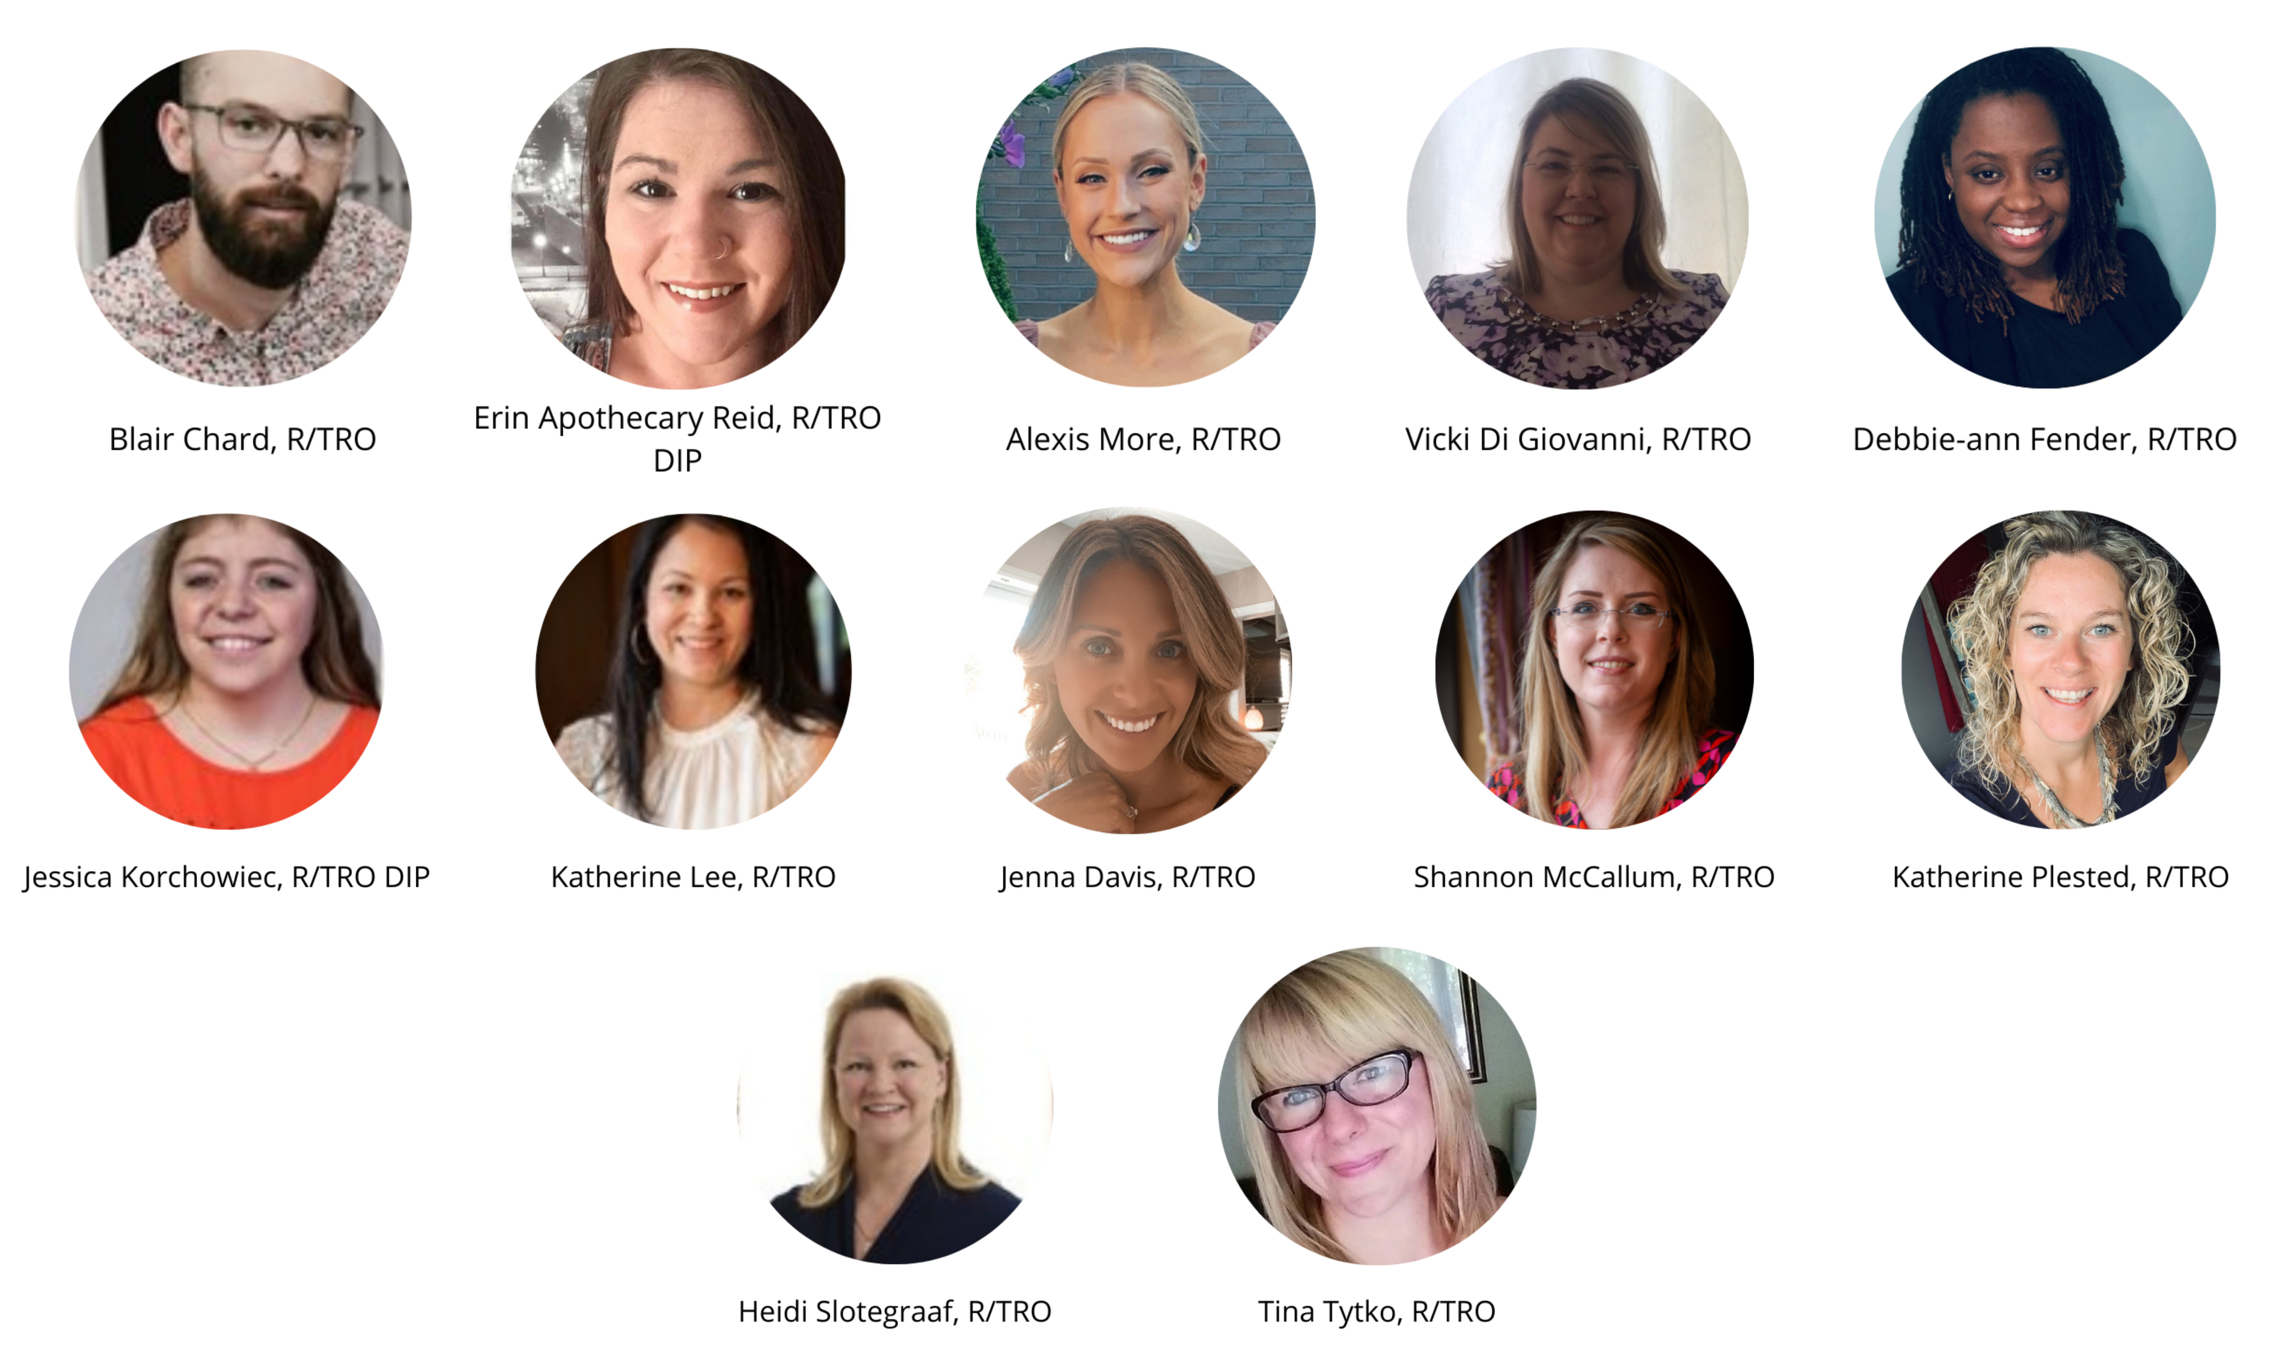
TRO’s Current Board of Directors
TRO’s 2021-2022 Board of Directors:
Shannon McCallum, R/TRO - President
Katherine Plested, R/TRO – Past President
Katherine Lee, R/TRO – President-Elect
Alexis More, R/TRO
Blair Chard, R/TRO
Debbie-Ann Fender, R/TRO
Erin Apothecary Reid, R/TRO
Heidi Slotegraff, R/TRO
Jenna Davis, R/TRO
Stacey Sestric, R/TRO
Tina Tyko, R/TRO
Vicki Di Giovanni, R/TRO

Slide 10

6. Financial Report
Sue Talmey, CPA, CMA

Slide 11

7. 2-1 Designation Update
Sue Verrilli, R/TRO

Slide 12

8. Other Business and Q&A Segment

Slide 13

9. TRO’s Annual Report
Video Link: https://www.trontario.org/news-events/events/agm.html

Slide 14

10. Adjournment of Meeting
AGM attendee to move the motion to adjourn the meeting
AGM attendee to second the motion

