Slide 1








TRO Conference 2024
DEIB
RESOURCE CLUB
Hashan Fontaine, Mary Afable (BA TR, MA RLS, R/TRO),
Rhiannon Buffett (R/TRO, CTRS)

Slide 2



Agenda
1
4
LEARNING OUTCOMES
SEARCH
2
5
BACKGROUND
RESOURCE BUILDING
3
6
DIGITAL CRITICAL THINKING
WRAP UP
Notes:
Rhiannon

Slide 3




Learning Outcome 2
Learning Outcome 1
Learning Outcomes 3
Create a list of at least 3 resources related to concepts in DEIB
Verbalize the importance of digital critical thinking
Identify 2-3 implications of the resources on Therapeutic Recreation Practice
Notes:
Rhiannon

Slide 4





Importance
Ethical Practice
Standards of Practice
Equality discusses how the therapeutic recreation practitioner has the responsibility to treat all clients fairly and equally when providing services. The therapeutic recreation
practitioner acknowledges and respects the diversity in backgrounds and
beliefs of all clients and ensures equitable opportunities for service and care.
(Therapeutic Recreation Ontario, 2007, para. 6)
SoP Professional Development outlines how practitioners should participate in ongoing learning and commit to the development of personal and professional goals. (p. 25)
SoP Community Practice identifies how we are to recognize that individuals have rights to inclusion in their community and with
their community. (p. 28)
(Therapeutic Recreation Ontario, 2012)
Notes:
Rhiannon

Slide 5



Inclusion
Diversity
Belonging
Equity
Notes:
Defining Terms
one line verbally on each?
Hashan
Point to website ?

Slide 6
Expanding our
Understanding
Books & Bevvies
DEIB Resource Club
One topic to explore
Resource connected to topic of focus
Reflection and conversation related to topic
Encourage knowledge and awareness building
Developed by membership for membership
Resources on multiple topics
Working document
Opportunity for continued connection knowledge and awareness building
Notes:
Mary to discuss this:
Timeline:
Subcommittee of TRO DEIB -
Idea of a book club formed as a social/casual effort to connect with TRO membership
1st meeting:

Slide 7
Digital Critical Thinking
Empathy
Emotional
Intelligence
Mind
Machine
(Del Campo, n.d.)
Notes:
Rhiannon
Mind over machine!
The internet is 'both the world's best fact-checker and the world's best bias confirmer - often at the same time' - michael lynch
So, how do we stay afloat in this tech-soaked world? Technology is everywhere, but it’s important to nurture our soft skills like empathy and emotional intelligence. Embrace lifelong learning, stay open to picking up new skills, and be mindful of technology’s impact on our daily lives. We can strike a balance between convenience and preserving our critical thinking skills, ensuring that we are in the driver’s seat.

Slide 8
Misinformation
Critical Thinking
Connection to DEIB
Information that happens to be incorrect
Thinking that is purposeful, reasoned and goal directed (Halpern, 2013)
As we continue to learn about the world around us, and people that we interact with, information that is available may or may not be accurate and inclusive.
We can apply digital literacy and critical thinking principles to support our growth and learning
Disinformation
Critical Ignoring
Information created and
presented with the intent to
spread false information
Choosing what to ignore and where to invest one’s limited attentional capacities.
(Kozyreva, et. al., 2022)
Notes:
Rhiannon, - Critical thinking
HAshan - Mis/disinformation
& Mary - connection to DEIB
Digital literacy and critical thinking should therefore include a focus on the competence of critical ignoring: choosing what to ignore, how to resist low-quality and misleading but cognitively attractive information, and deciding where to invest one's limited attentional capacities
Mindful thinking - how do we discern?
ChatGPT - where are they pulling from? They don't provide references

Slide 9
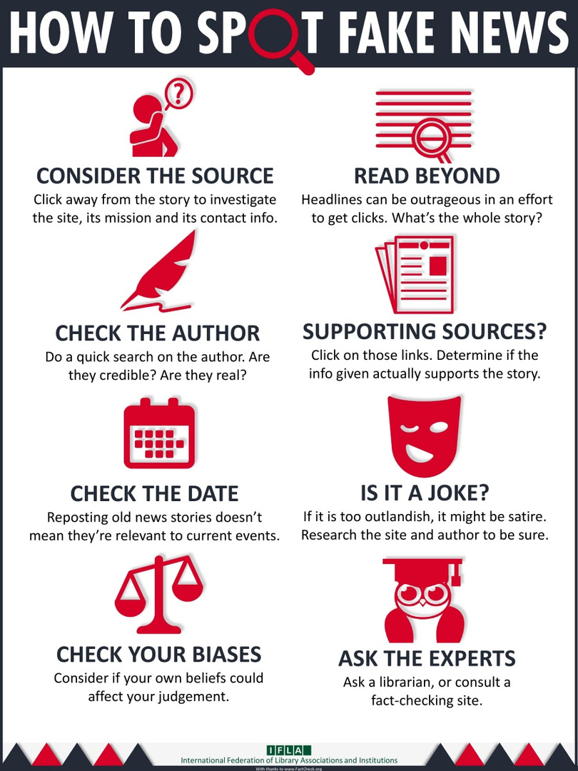
Let’s
DISCERN
Notes:
Mary to discuss this -
Focus on discerning information personally
See graphic from IFLA

Slide 10

Digital Critical Thinking & DEIB
LET’S
SEARCH
Notes:
Mary - Introduce and expand
Use this acronym
Describe meanings of
Seek
Evaluate
Accountable
Relevant
Compare
Humanize
Using AI technology re: Chat GPT -
Being mindful of validity
Using critical thinking skills

Slide 11
Seek
Relevant
Choose to find a specific resource, topic, issue, concern
The resource is important to highlight as it relates to the topic of focus
Evaluation
Digital Critical Thinking & DEIB:
SEARCH
Compare
The content length and type of information provided
Pros and cons between resources found
Accountable
Humanize
The resource is accountable to the topic of focus
Empathic and compassionate relationship to resources
Notes:
Does this visual look okay and we can input the definitions here?

Slide 12





Digital Critical
Thinking Exercise
SPORT & GENDER
SPORT & GENDER
SPORT & GENDER
SPORT & GENDER
SPORT & GENDER
Notes:
Rhiannon & Mary
Topic: Sport & gender equality
Search for resources related to topic
2 minute search
What did you find? What questions did you ask yourself as you read the information? Who was the information from?
Review a couple SEARCH concepts in debrief?

Slide 13
Build Your Resources!
What types of resources
CAN WE ACCESS?
Notes:
Hashan

Slide 14

Fiction &
Non-Fiction
Professional Development
Documentaries
Podcasts
(Social) Media
Subject Matter Experts
Essays
Academic Resources
Notes:
Hashan
Define the various types of resources...
include a written brief description & verbally share?
Fiction and Non-Fiction
Fiction is literature created from the imagination and Nonfiction refers to literature based on fact.
Professional development
Formal types of gaining new skills through continuing education and career training.
Documentaries
A film that tells a story about real-life events and is based on reality rather than being made up.
(Social) Media
Interactions among people in which they create share and/or exchange information and ideas in virtual communities.
Subject matter experts
who provides the knowledge and expertise in a specific subject.
Academic Resources
Sources are written by experts or authorities in a specific field of study and can be found in academic journals.
Essays
Written answer that includes information and discussion.
Podcasts
Digital audio content is distributed over the internet using a podcast hosting service.
It is more than just reading!
What other sources can you think of?

Slide 15

What is important to me
Gender Equality
Cultural Awareness
(Dis)ability Rights
Mental Health
Human Rights
Notes:
Mary
And to the clients we support...
this should guide your curiosity & what resources you should start to seek out
Add in a few more examples:
Gender Equality
Human Rights
(Dis)ability Rights
Mental Health
Cultural Awareness
Consider Positionality - refers to where one is located in relation to their various social identities (gender, race, class, ethnicity, ability, geographical location etc.); the combination of these identities and their intersections shape how we understand and engage with the world, including our knowledges, perspectives, and teaching practices. As individuals and as instructors, we occupy multiple identities that are fluid and dialogical in nature, contextually situated, and continuously amended and reproduced.
(Alcoff, 1988 ).
-Who you are, what you are influenced by, your "location" and Intersectionality
(gender, race, ethnicity, class, geo location, ability)
-What lens(es) do you see through?
What are we uncomfortable
SLIDO: (DONE)
What is important to me? What am I curious about?

Slide 16
How to find resources
Things to consider:
Using specific key words to focus your search
Seek peer-reviewed sources when possible
Mindfully engage with social media resources
Recognize your positionality
Word of mouth is powerful
Use the SEARCH method
Notes:
Mary -
Using several keywords
Being mindful with what resources you find
Positionality is here, but think it is discussed in a future slide?

Slide 17
Cultivation: DEIB Resource Club
One theme per group
Start with a theme that resonates with you
Rotate through three themes - 8 mins each
SEARCH, discern and add resources related to the theme
Don’t forget the various types of resources
We will review and discuss briefly at the end of the activity
These resources will then be shared as part of the DEIB Toolkit on TRO Website
Notes:
Rhiannon
Add in some rules as we then move into workshop portion of the session
One topic per paper
~5 topics, 6 ppl per topic
8 mins per table
switch
add to next topic
Prebrief
Debrief
coloured cardstock (table themes)
white chart paper
chart paper markers
Walk around prompt with:
Are these resources to watch, listen, read?

Slide 18
TR Connection
Utilize these resources in our professional work:
Explore
Share
Contribute
Notes:
Rhiannon (debreifing from activity)
sharing
contributing
exploring

Slide 19




Next Steps
Embed Resources into larger
DEIB Toolkits
Stay curious!
See you this afternoon!

Slide 20


Thanks!

Slide 21
References
Del Campo, R. (n.d.). How to preserve critical thinking in a digital world. Retrieved from https://authentikaconsulting.com/how-to-preserve-critical-thinking-in-a-digital-world/
Halpern, D. (n.d.). Critical thinking workshop for helping our students become better thinkers. Retrieved from https://louisville.edu/ideastoaction/-/files/featured/halpern/critical-thinking.pdf
Kozyreva, A., Wineburg, S., Lewandowsky, S., & Hertwig, R. (2023). Critical Ignoring as a Core Competence for Digital Citizens. Current Directions in Psychological Science, 32(1), 81-88. https://doi.org/10.1177/09637214221121570
Therapeutic Recreation Ontario. (2007). TRO Code of Ethics. Retrieved from
https://www.trontario.org/wp-content/uploads/2023/08/tro_code_of_ethics_8.51-1.pdf
Therapeutic Recreation Ontario. (2012). Standards of practice for Recreation Therapists and Recreation Therapy Assistants.
Retrieved from https://www.trontario.org/wp-content/uploads/2023/03/SOP_final_draft_EN_March_2019_final.pdf

