Slide 1
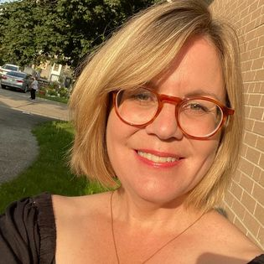
Boomwhackers and Bell Choirs
Dawn Ellis-Mobbs
Director of Programs and Community Partnerships
Room 217 Foundation
www.musiccare.org

Slide 2
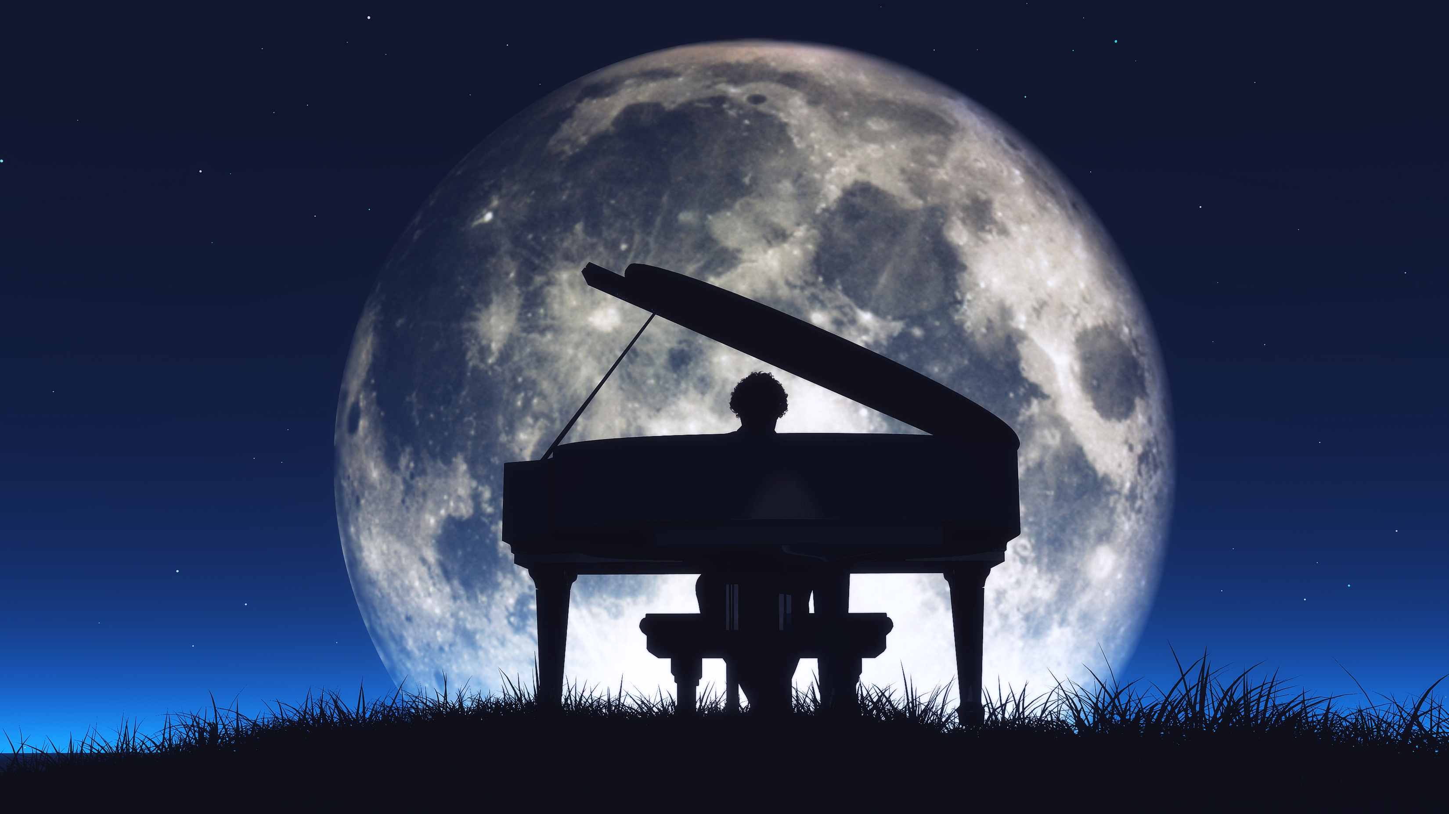
Reflection Question
Think of one song or piece of music that has meaning to you.
Any genre, any piece. No judgements, no questions asked.
Write it on a post it note. Place it on the giant post it note in the room.
What is your personal relationship with music?

Slide 3

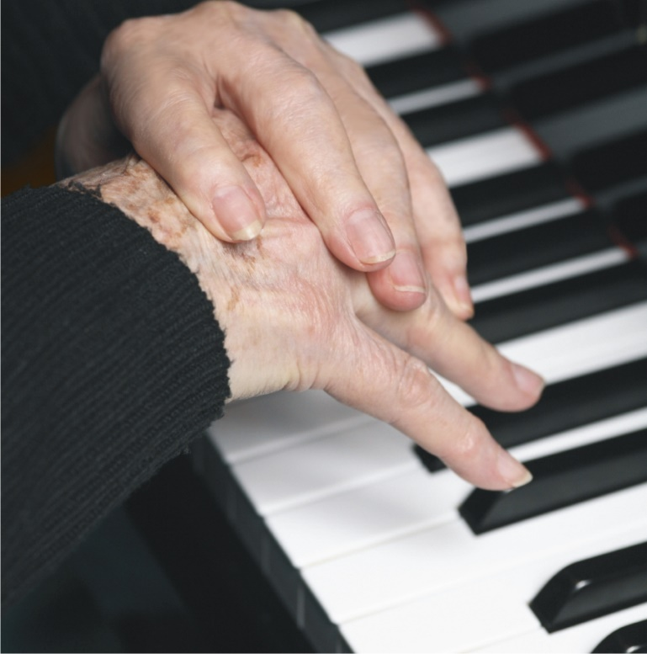

What is the story of Room 217?
The Room 217 Foundation is a health arts organization that uses music to change the culture of care (Est. 2009)
In Room 217 at the Uxbridge Cottage Hospital, music changed the end-of- life experience for one Canadian family

Slide 4


About the Room 217 Foundation
We are considered national and global leaders in music care education
We partner in music care research i.e., McMaster Health Sciences, Laurier Music in the Community; our programs are research-informed
We have relationships with stakeholders in Aging Adult Communities, Adult Day Programs, Hospice Palliative Care across Canada, Educational institutions
Our tools and training work
‘Room 217 has earned the right to set a standard. We need this. We need it now.’
- Dan Cohen, Founder/CEO, Right to Music and Founder, Music & Memory, USA
Music Care Conference

Slide 5
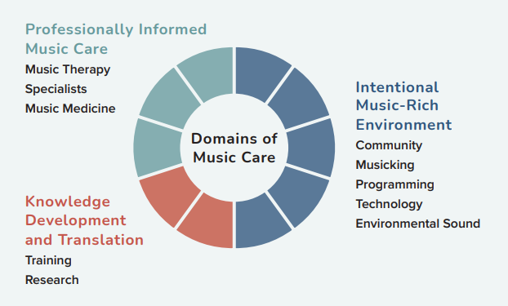
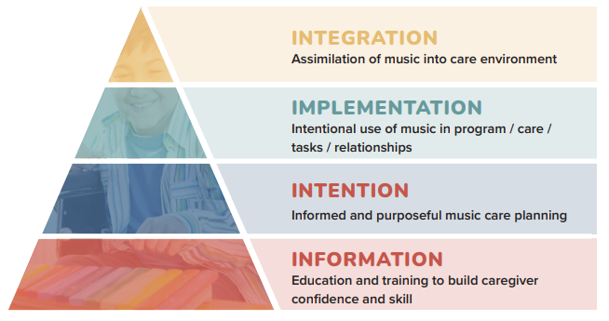
Integrated Model of Music Care
10 Domains of Music Care Delivery
Music Care Integration Framework
3 part study
Music & Medicine, 2016
2 part study
Healthcare Journal, 2021

Slide 6
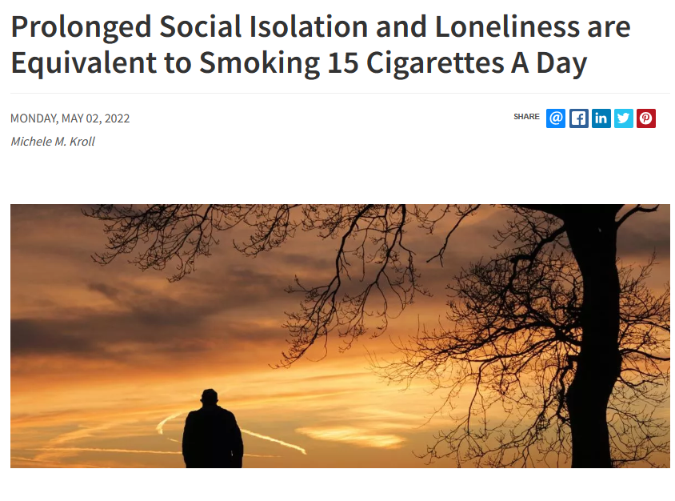

Slide 7
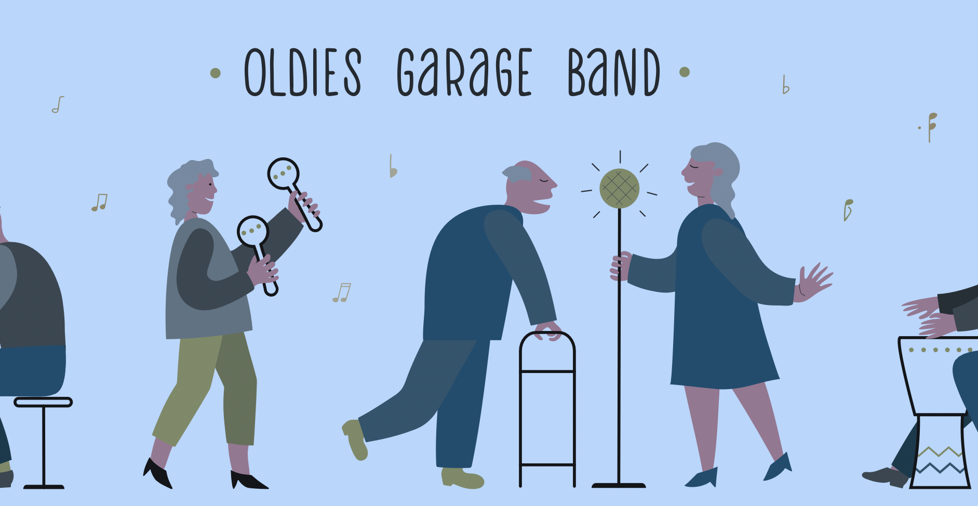



One music intervention is not enough
Mix and Match Music Programs, Approaches, Timing
Singing – planned and spontaneous
Making music
Live music
Receptive listening by oneself, with others
Dance
Programs – Apps – Smart speakers
Notes:
What would be an optimal combination of singing, making music, dance, live music, receptive listening along with national programs, apps and smart speakers for your residents?
Let’s provide vigorous access to music in all its forms.

Slide 8
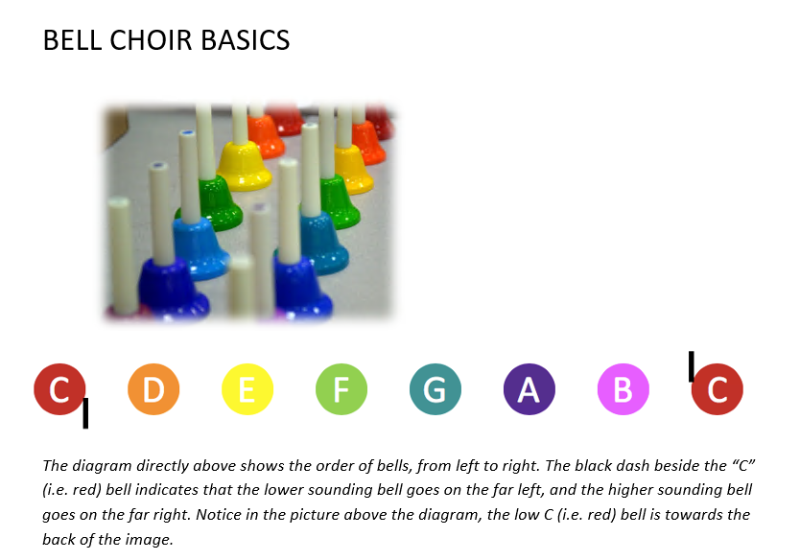

Slide 9
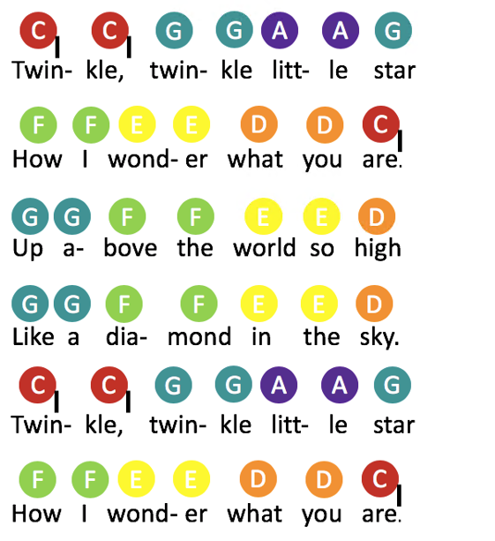
Twinkle Twinkle Little Star
Note that not all notes are covered in this song.
What strategies could you use for this song to include all 8 positions or notes in the bell/boomwhacker set?

Slide 10
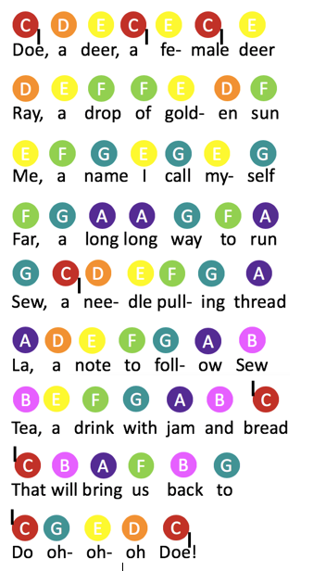
Do-Re-Mi
This song uses an entire major scale – which means no participants will be left out.
Fun Fact: This song originated in the Sound of Music.

Slide 11
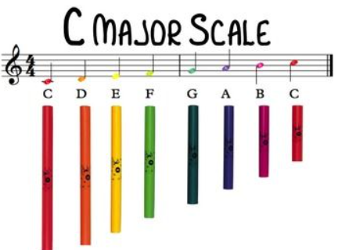
The Boomwhacker Scale

Slide 12

“Listening to music can reduce anxiety, blood pressure, and pain as well as improve sleep quality, mood, mental alertness, and memory.”
Notes:
How does this information impact how we perceive music and health CARE.
How important is it for healthcare professionals to take advantage of these system-altering impacts of music?

Slide 13
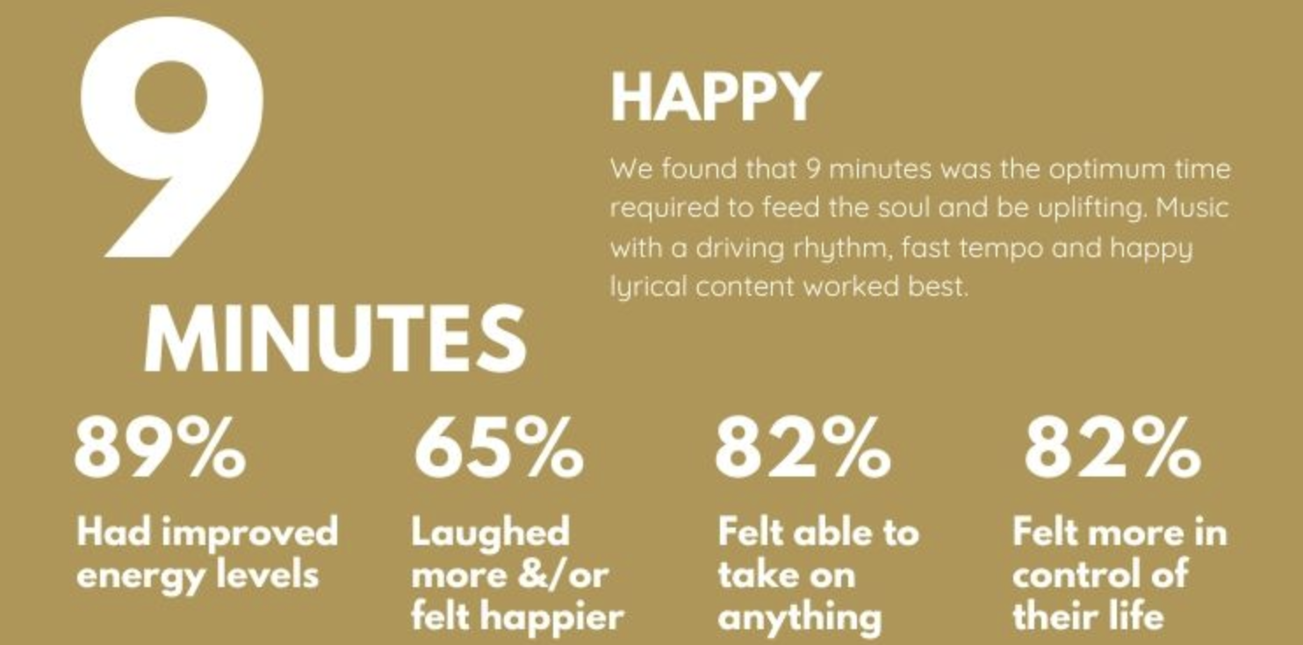
Notes:
We all range on our love of music. 3-5% of the population have no response at all, no brain activity change. Others will say they can't live without it. The rest of us fall in between.

Slide 14

musiccare.org

