Slide 1

Social Club
A framework for empowering youth through social opportunity

Slide 2
Todays Schedule
Let’s Experience a mini Social Club!
As you arrive and settle in
Place your clip on the Mood meter
Contribute an idea to the Investigation Station: How might you get to know someone
Arrival Activity: Dealers Choice – What Bugs Me or Finish The Comic
Meeting
Arrival Activity Share
Ice breaker: one thing in common
IS Debrief
Group Challenge
Activity: Dream World
Dream world walk about.
2 things we have learned about someone
Appreciations
_______________________________
Social Club presentation
Framework Fun
Debrief

Slide 3
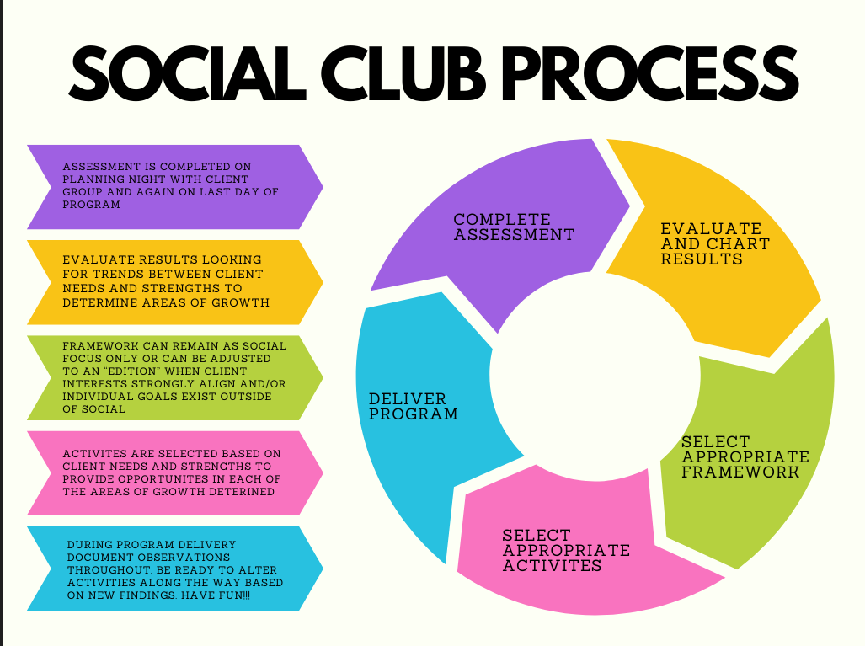

Slide 4
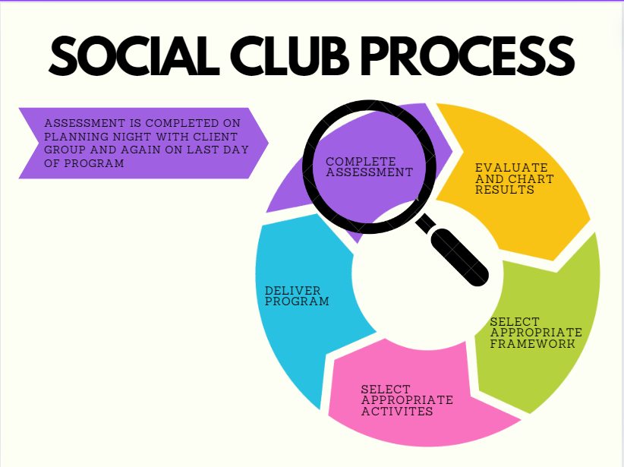

Slide 5
Assessment: Measurement of Social Empowerment & Trust
The SET measures changes in a client’s social attitudes and skills as a result of involvement in a treatment program.
This 28-statement assessment takes about 15-20 minutes to administer and score.
Measurements are obtained in five areas:
Bonding/Cohesion
Empowerment
Self-Awareness
Affirmations
Awareness of Others
Arbor, I. (1992). Measurement of Social Empowerment and Trust (SET). Idyll Arbor. https://idyllarbor.com/product/measurement-of-social-empowerment-and-trust-set/

Slide 6
Assessment: Measurement of Social Empowerment & Trust
Bonding and Cohesion
Can get along with a group
Am able to accept responsibility
Believe that cooperation means accomplishment
Have trust in relationships with teachers/leaders
Feel accepted by others
Know how to build trust, step-by-step
Am not trusted by others
Cannot cooperate with others
Empowerment
Am willing to take risks
Can learn new skills
Am willing to try new things
Feel “I’ll try” rather than “I won’t”
Can overcome fears
Have a negative attitude regarding healthy physical activities
Believe there are many thing I can’t do
Affirmations
Realize I can have fun without alcohol/drugs
Can be a member of a team
Have a positive perspective on what I can accomplish
Do not accept my strengths and weaknesses
Self-Awareness
Understand how my actions affect others
Am aware of my feelings
Feel confident in myself
Understand myself
Feel bad about myself
Am not in control
Arbor, I. (1992). Measurement of Social Empowerment and Trust (SET). Idyll Arbor. https://idyllarbor.com/product/measurement-of-social-empowerment-and-trust-set/

Slide 7
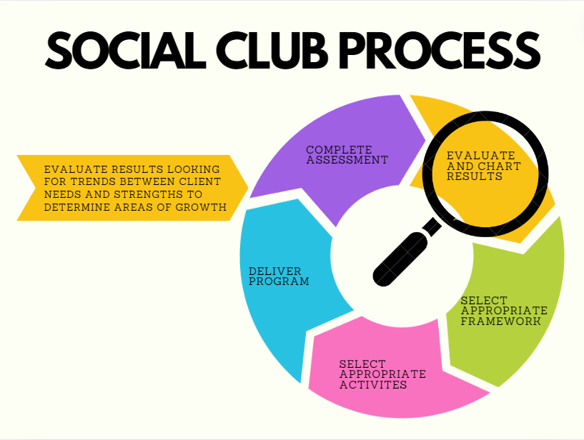

Slide 8
Assessment results and planning!
Reviewing results
Look for:
Individual areas of growth overall and look at individual questions
Individual areas of strength
commonalities
Transferring individual results of the SET to guide program planning
Transfer findings into chart
Develop morning questions and group challenges
Select activities that will address areas of growth
Utilize client strengths to encourage peer to peer modeling and learning

Slide 9
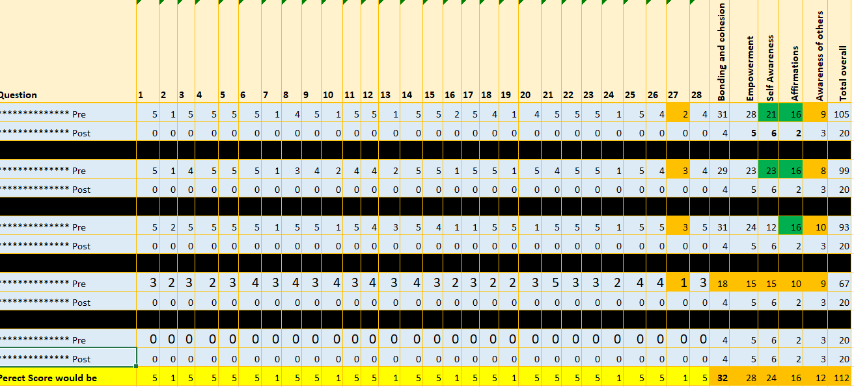

Slide 10
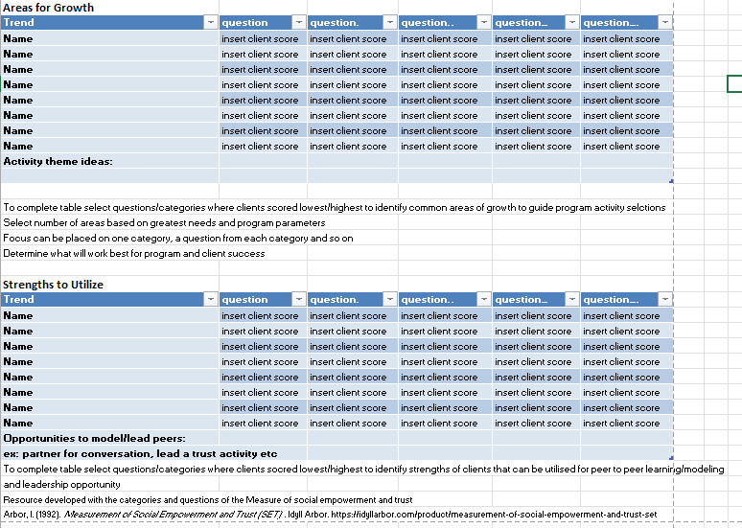

Slide 11
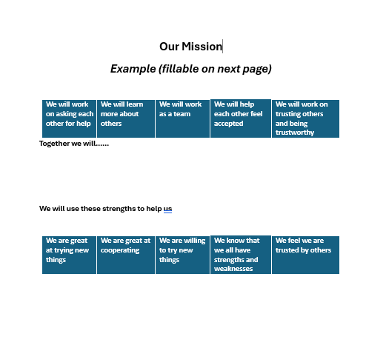

Slide 12
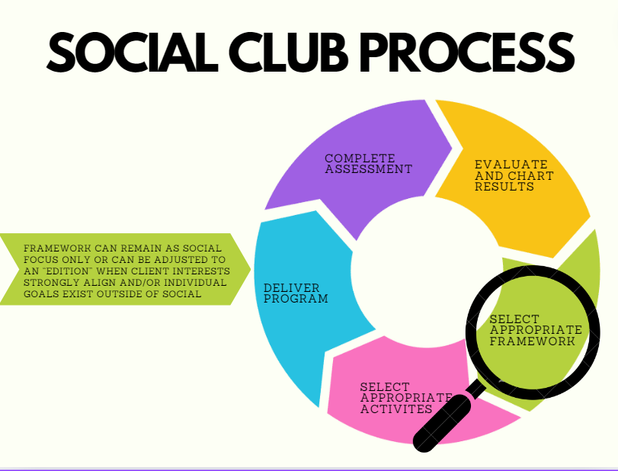

Slide 13
Social Club Frameworks
Original Templates
One week, 6 hour days
Evenings – 1, 2 hour session per week for 8 weeks
Editions
The possibilities are endless! Frameworks can easily be adjusted to have the interest of like-minded peers applied
The Arts edition
Book club edition
Stay active edition
Night out edition
Makers Market edition

Slide 14
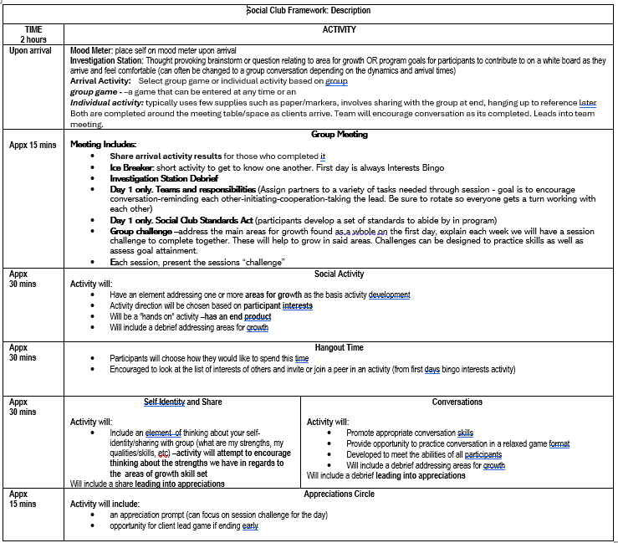

Slide 15
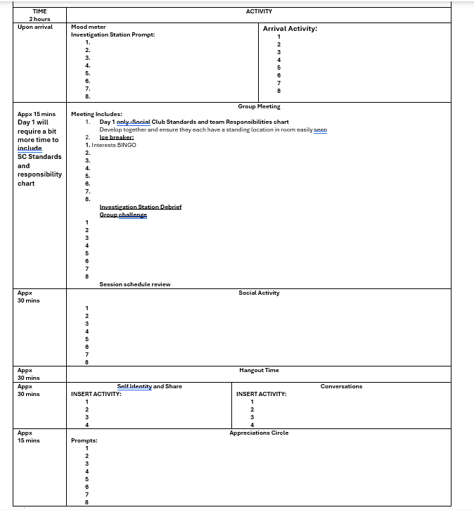

Slide 16
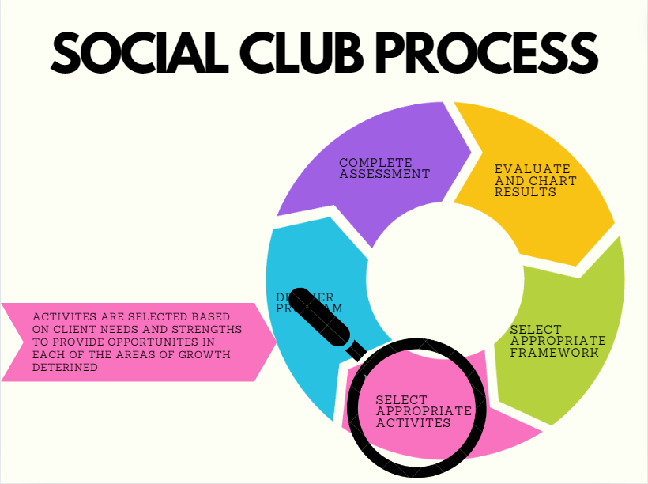

Slide 17
Mood Meter
Mood check ins
Can help to know how to approach the day/client
Can acknowledge similar feelings to peers
Can recognize ways to improve mood or support
Self regulation support
Encourages clients to recognize and share their feelings
Can add suggestions of things to do when identifying a particular way
Assessment
Ex: Will recognize improved frame of mind after physical activity

Slide 18
Arrival Activities
Select based on group preferences
Group game –a game that can be entered at any time
Ex: 20 questions, wordle, Pictionary
Individual activity: typically uses few supplies such as paper/markers, involves sharing with the group at end, hanging up to reference later
This is completed around the meeting table/space as clients arrive. Team will encourage conversation as its completed. Leads into team meeting.
Ex: What bugs me, complete the comic, doodle prompts

Slide 19
Investigation Station
Brainstorm style
Question is written on a white board
Question is developed based on the areas of growth and/or the theme for learning that day
Participants are invited to add things to it as they come in. This works well for independent thinking as well as for those individuals who prefer a quieter approach
This will be reviewed at the morning meeting, contributions can be made at that time as well
If everyone arrives at once or it is more appropriate for the group this can be completed altogether as well at the morning meeting instead

Slide 20
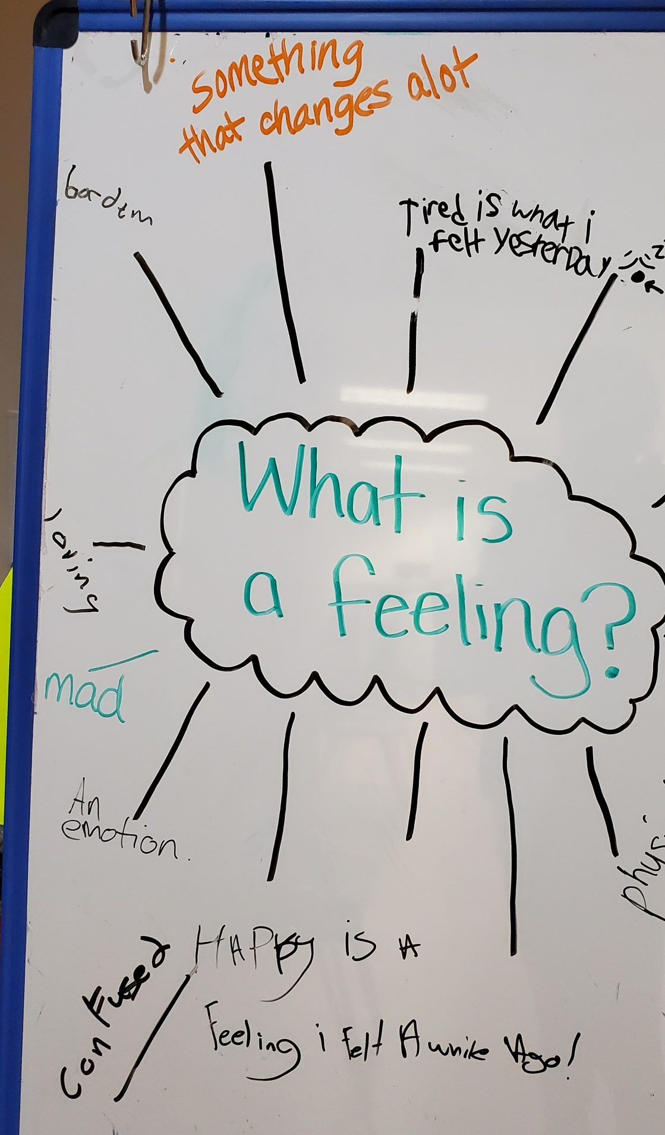
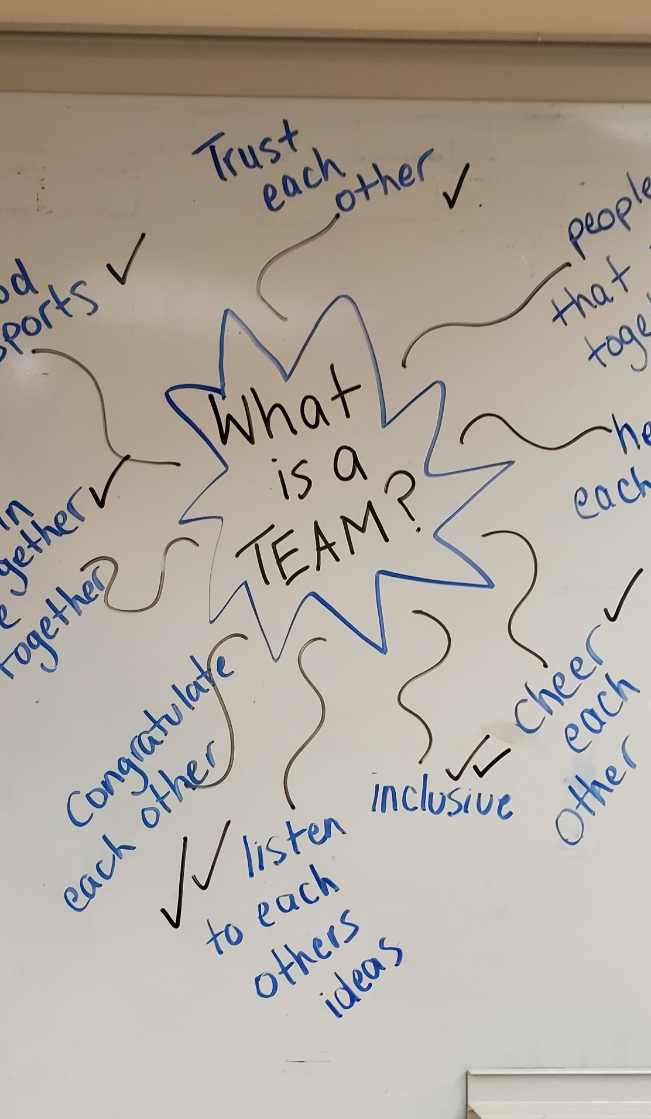
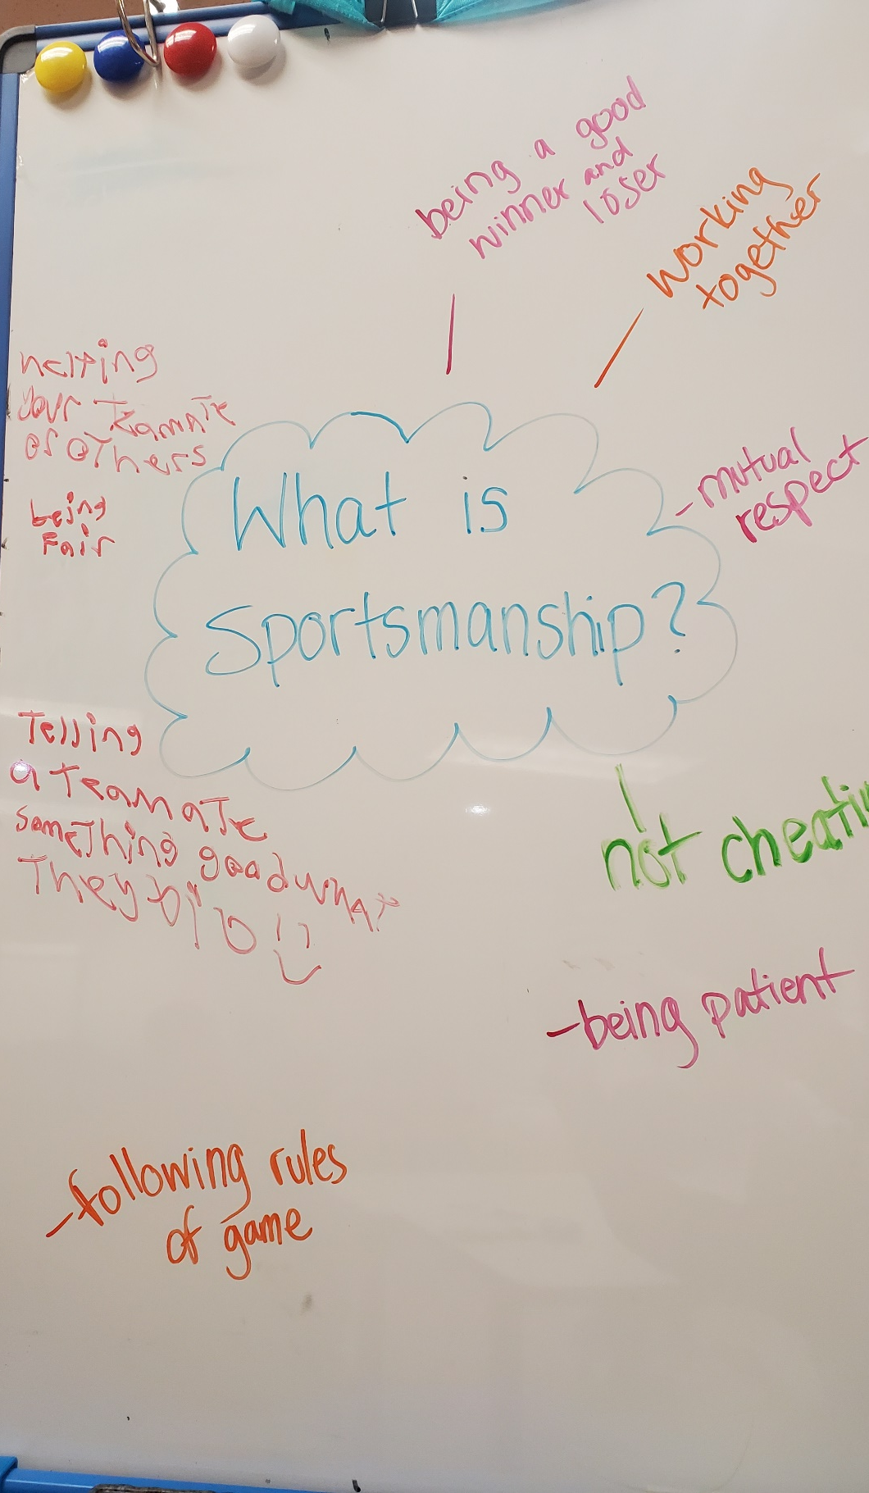

Slide 21
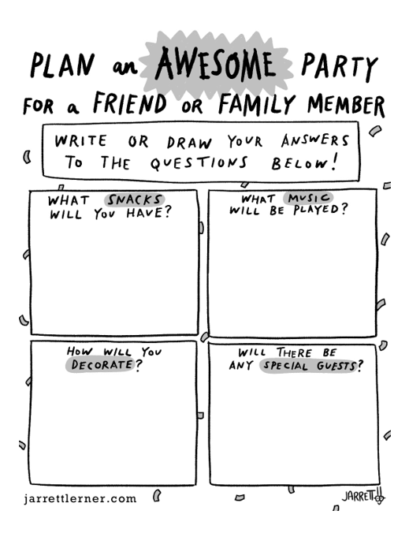
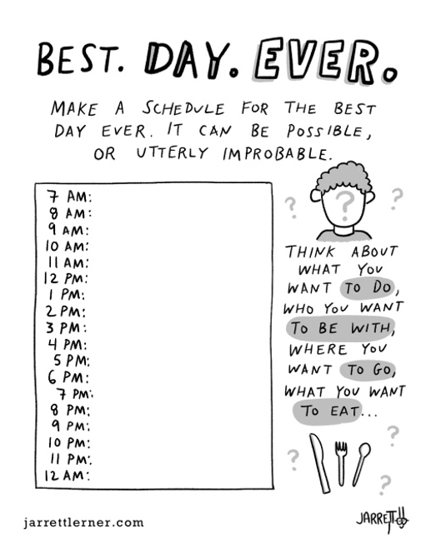
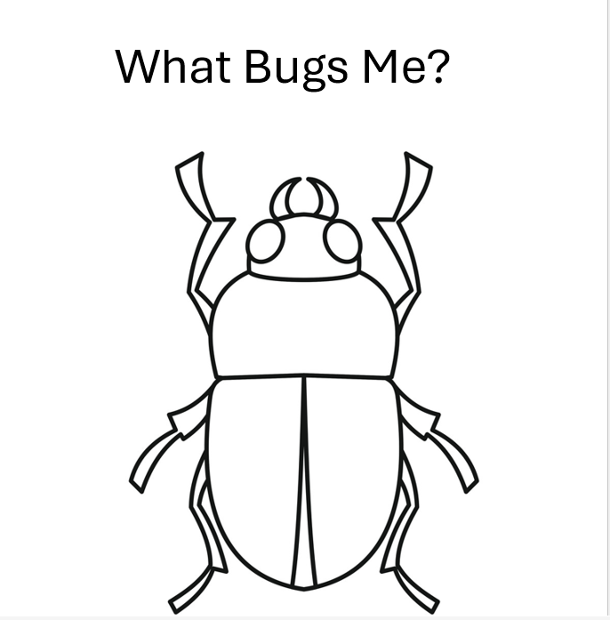

Slide 22
Group Challenge
This can be used as both a way to practice skills as well as assess progress. Challenges can be designed in such a way that they are directing goal attainment
The group challenge does not require time set aside as it should be things that are occurring through the day
Challenge Yourself: An individual chart where challenges are checked off by participant as they feel they have accomplished them
Group Challenge board: an existing space on wall where each day a new challenge is added
Social Squares This is an activity card game where clients select a social challenge from a card deck during down times and as they complete them they tack to wall. At least one must be done per day!

Slide 23
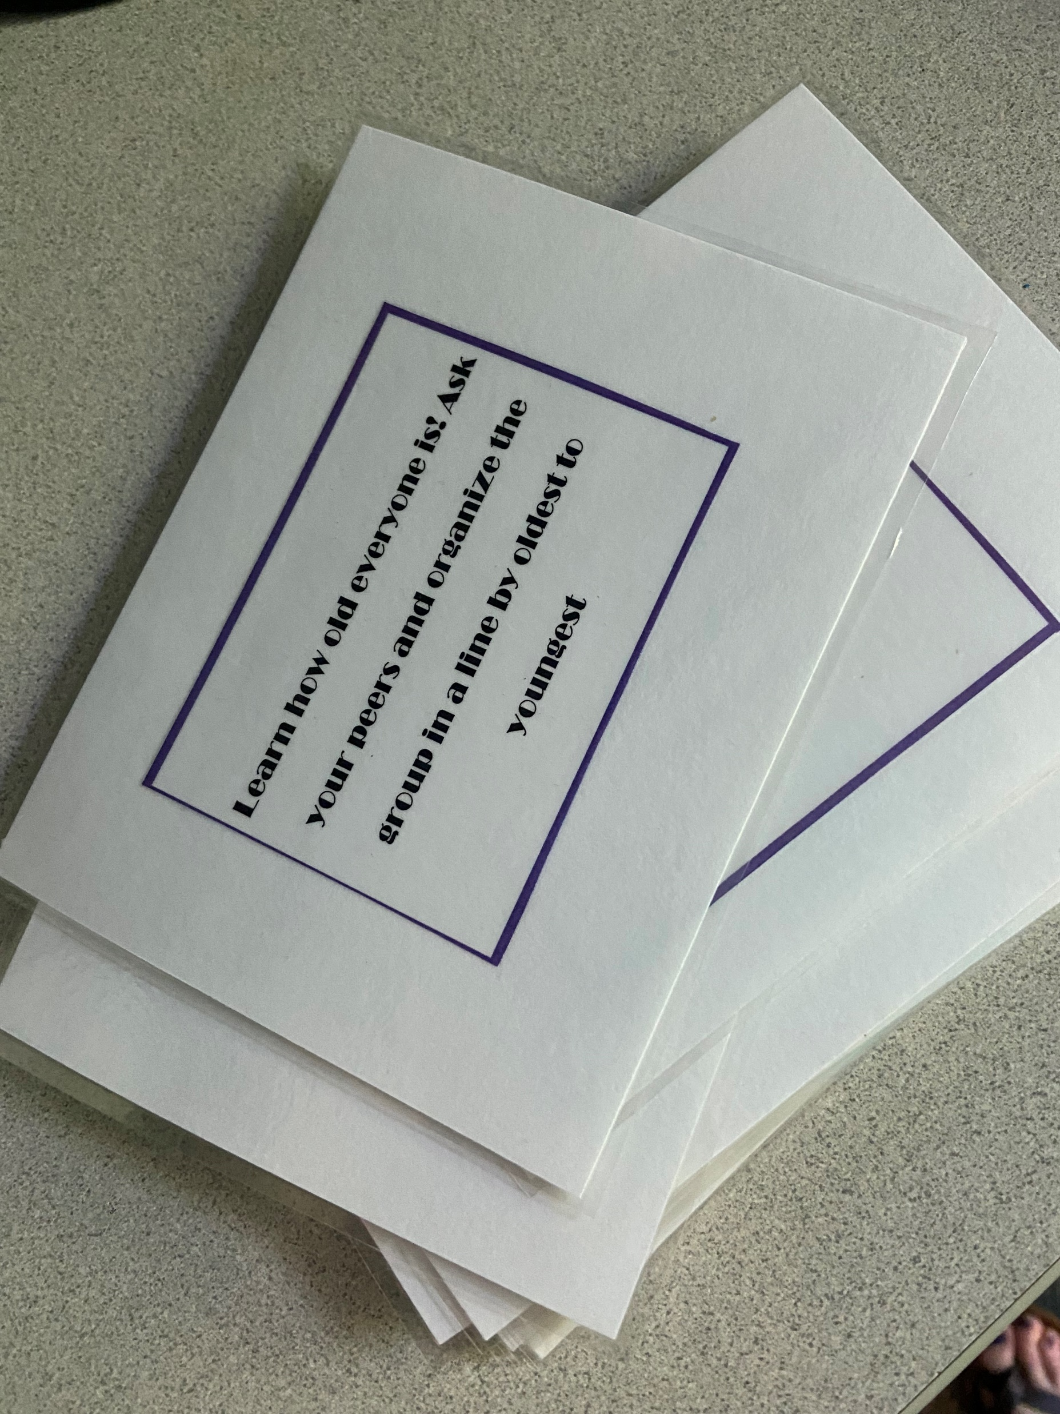
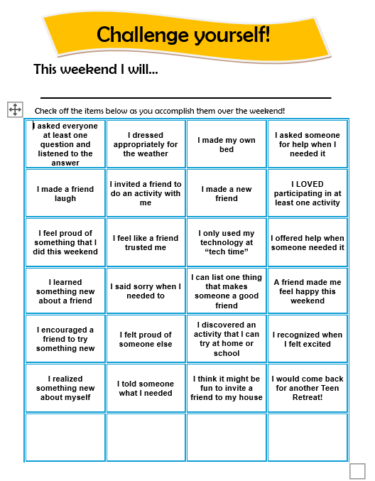
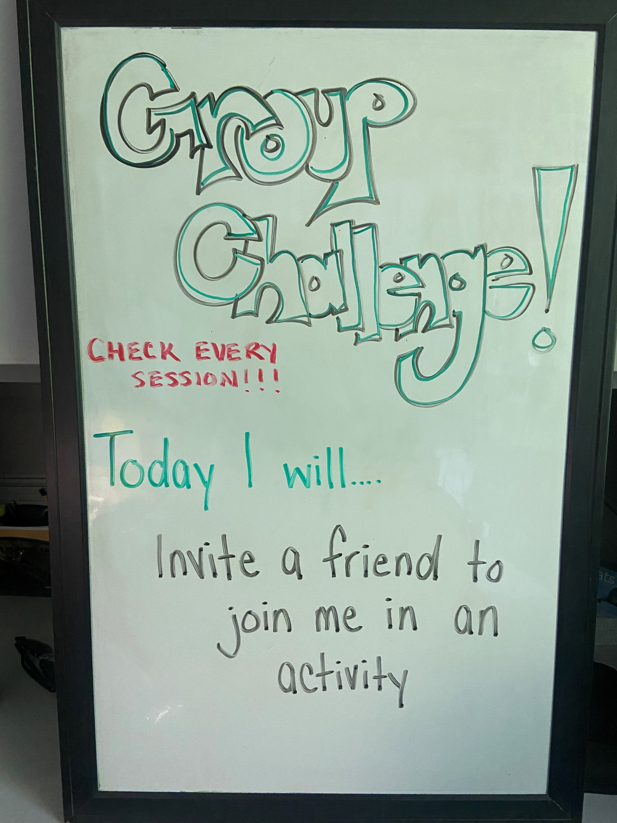

Slide 24
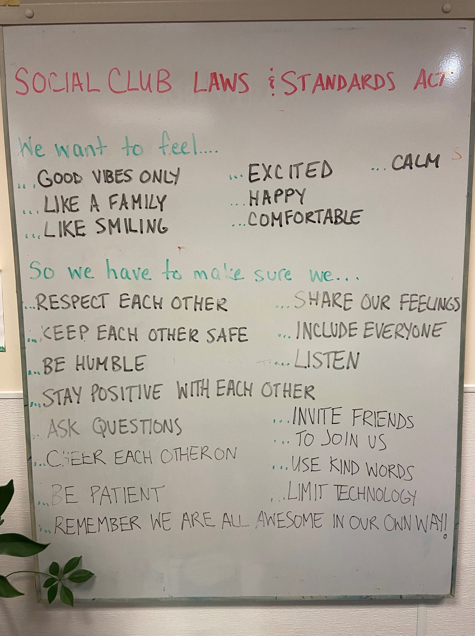
Social Club Laws and Standards Act
This name was developed by clients.
We asked “Rules sounds to strict, what else could we call it?”
We want to feel…
So we have to make sure we…
Clients brainstorm together
No wrong answers –but may need help framing in the positive

Slide 25
Main Activities
Social Activity (with interests theme)
Activity will:
Have an element addressing one or more areas for growth
Activity direction will be chosen based on participant interests (Cooking/Science/DIY/Visual Arts)
Activity will have an end product
Will include a debrief
Self Identity and Share
Activity will:
Include an element of thinking about your self-identity/sharing with group (what are my strenghts, my qualities/skills, etc) –activity will attempt to encourage thinking about the strengths we have in regards to the areas of growth skill set
Conversations
Activity will:
Promote appropriate conversation skills
Provide opportunity to practice conversation in a relaxed game format
Developed to meet the abilities of all participants
Will include a debrief addressing areas for growth

Slide 26
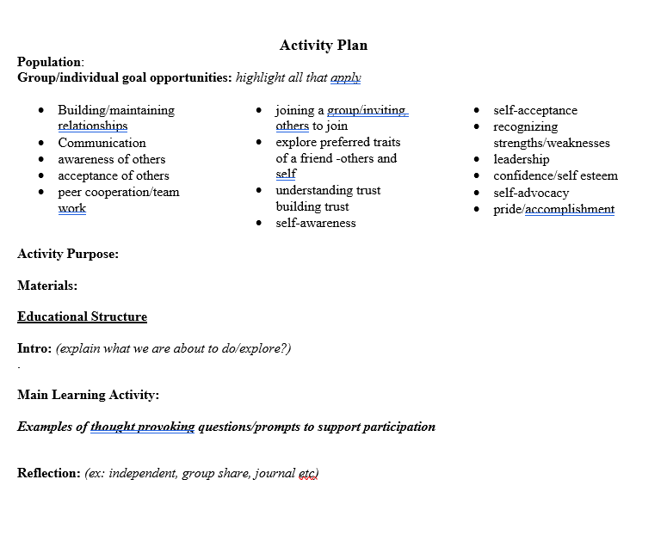

Slide 27
Appreciations
Activity will include:
an appreciation prompt (can focus on session challenge for the day)
opportunity for client lead game if ending early

Slide 28
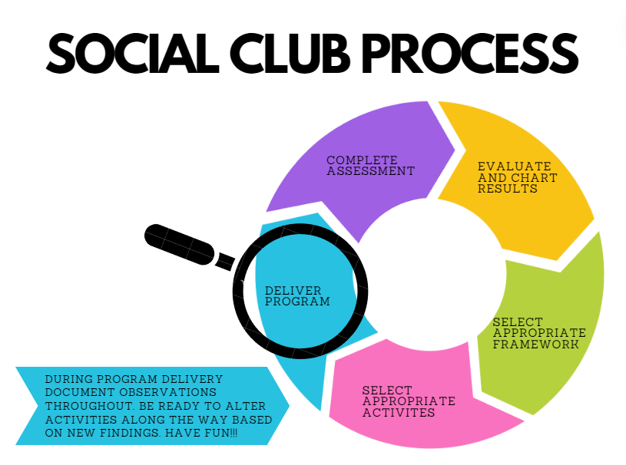

Slide 29
Delivery
Modeling: The team models appropriate skills throughout entirety of program as opposed to telling. Discussion can occur ahead and then the skill is modeled as well.
Ex: approaching a group to join in. “Lets try it together” Model what to say and the act of joining in. Scale back each time
Peer to peer: Encourage peer to peer learning. This supports building upon strengths, encourages leadership and builds confidence and self esteem in the “teacher peer” as well as offers a relatable experience for the “learner peer” We find participants are more eager to follow peers then being told by an adult
Practice: Ensure there are opportunities for all participants to practice skills naturally and with a variety of levels of support.
Ex: Opportunities are offered structured with higher monitoring during planned activities. Opportunities can also be set up around the space to occur naturally –Interests Bingo, materials for chess just happen to be out on the games table etc

Slide 30
Meaningful social interactions
And Quality of Life
Building Friendships. Decreasing loneliness
“They went to their first birthday party this weekend” (with a friend they met in social club)
“They started a DnD group with friends from school. We have never had kids to the house”
Maintaining Friendships
“I missed you last week”
Improving Mood
“He is elated. I can’t stop smiling, thank you so much” (after first program session)
Leadership. Learning new skills
“We had a sleepover on the weekend and made up a dance to show everyone”
Let’s head to
The Rec Room
to see it in action!
Independence
“They made a plan to go to the mall together, she was so excited to hang out alone with a friend”

Slide 31
Lets try it!
The assessment has been completed
Results have been evaluated and charted
Interests have been considered.
A mission statement for clients to review and sign together has been formed based on trends, strengths and needs.
As a group use this to insert activities for one entire session (the 1. in every section on framework)

Slide 32
Discussion

