Slide 1

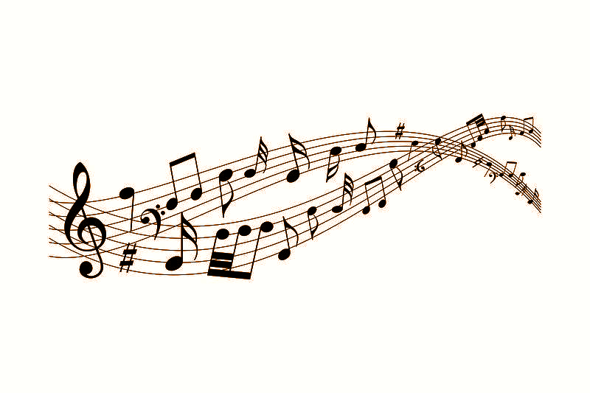
Harmony in Collaboration
Bridging Therapeutic Recreation Practice & Music Therapy for Holistic Client-Centred Care
Mary Anne Afable, BA TR, MA RLS, R/TRO
Sophia Christopher, MA-CPIN, MTA, NMT-F, RP
Melissa Tennant, MA, R/TRO

Slide 2
Welcome & Acknowledgements
We acknowledge that we represent the land known as Waterloo Region (which includes the cities of Waterloo, Kitchener and Cambridge, and the townships of Wellesley, Wilmot, Woolwich and North Dumfries), the land on which I live and work and study, is situated on the Haldimand Tract; land promised to the Haudenosaunee of the Six Nations of the Grand River. It is the traditional territory of the Neutral, Anishinaabeg, and Haudenosaunee peoples, here on Turtle Island.
Notes:
This is a healthy practice I engage in, to mindfully remind myself that what I can offer as knowledge and in my practice in TR, I pass on, in hopes that it leads to healing, less hurting, and for the purposes of creating and maintaining connection, rather than disconnection.

Slide 3
Welcome & Acknowledgements
Today, we acknowledge that we are on land situated on the traditional territories of the Erie, Neutral, Huron-Wendat, Haudenosaunee and Mississaugas of the Credit First Nations. This territory is covered by the Upper Canada Treaties and within land protected by the Dish With One Spoon Wampum Belt Covenant which was an agreement between the Haudenosaunee and Anishinaabek to share and care for the resources around the Great Lakes.
Notes:
Mary

Slide 4
Welcome & Acknowledgements
:Black lives matter :BIPOC lives matters :LGBTQIA+ lives matter :LOVE W​INS
Lastly, we acknowledge our identities and privileges, within colonial-settler structures that we are immersed in, acknowledging the land we work on, the people who have been here before us, out of respect and recognition of our privilege. We acknowledge those who provided us with what we know now and share this with you, as well as express the values we hold personally and professionally, in trust that we all use this knowledge to learn, lift and support one another.
Notes:
Mary

Slide 5
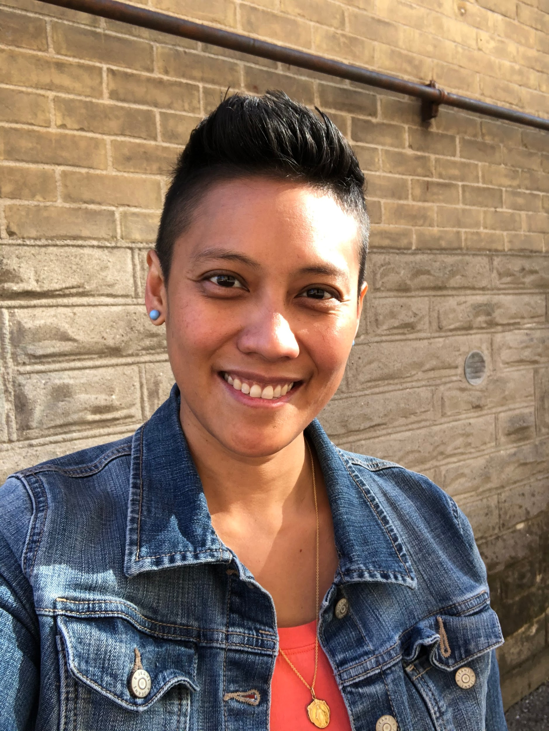
Introductions
Mary
Recreation Therapist - Grand River Hospital (GRH) Freeport
BA Therapeutic Recreation
MA Recreation & Leisure Studies
R/TRO: 15+ years of TR practice
Focus: Mental Health and Alternative Level of Care
Notes:
Mary

Slide 6
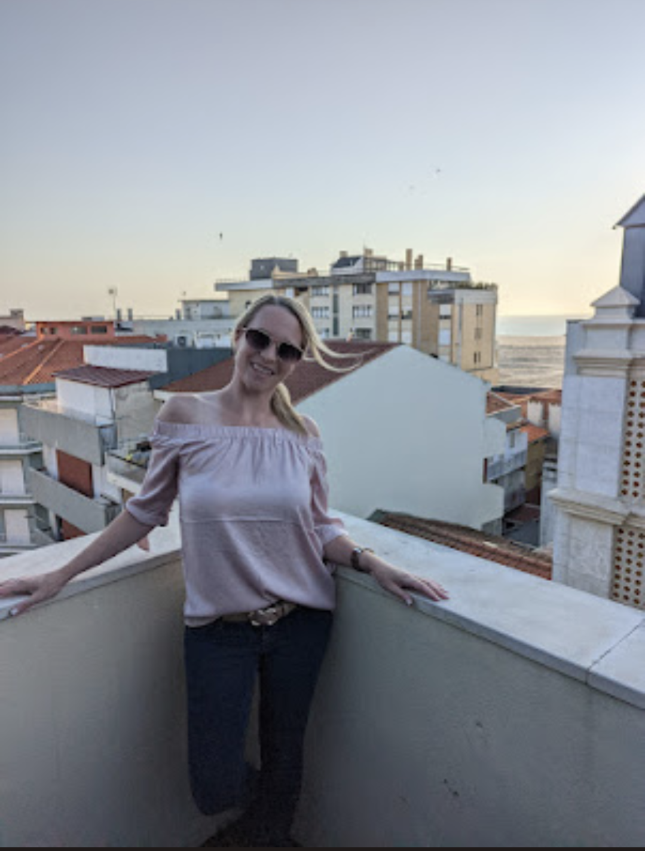
Introductions
Melissa
Recreation Therapist- GRH-Freeport
R/TRO: 8 years TR experience
M.A Interdisc. Health
Focus: inpatient and outpatient rehab and CCC

Slide 7
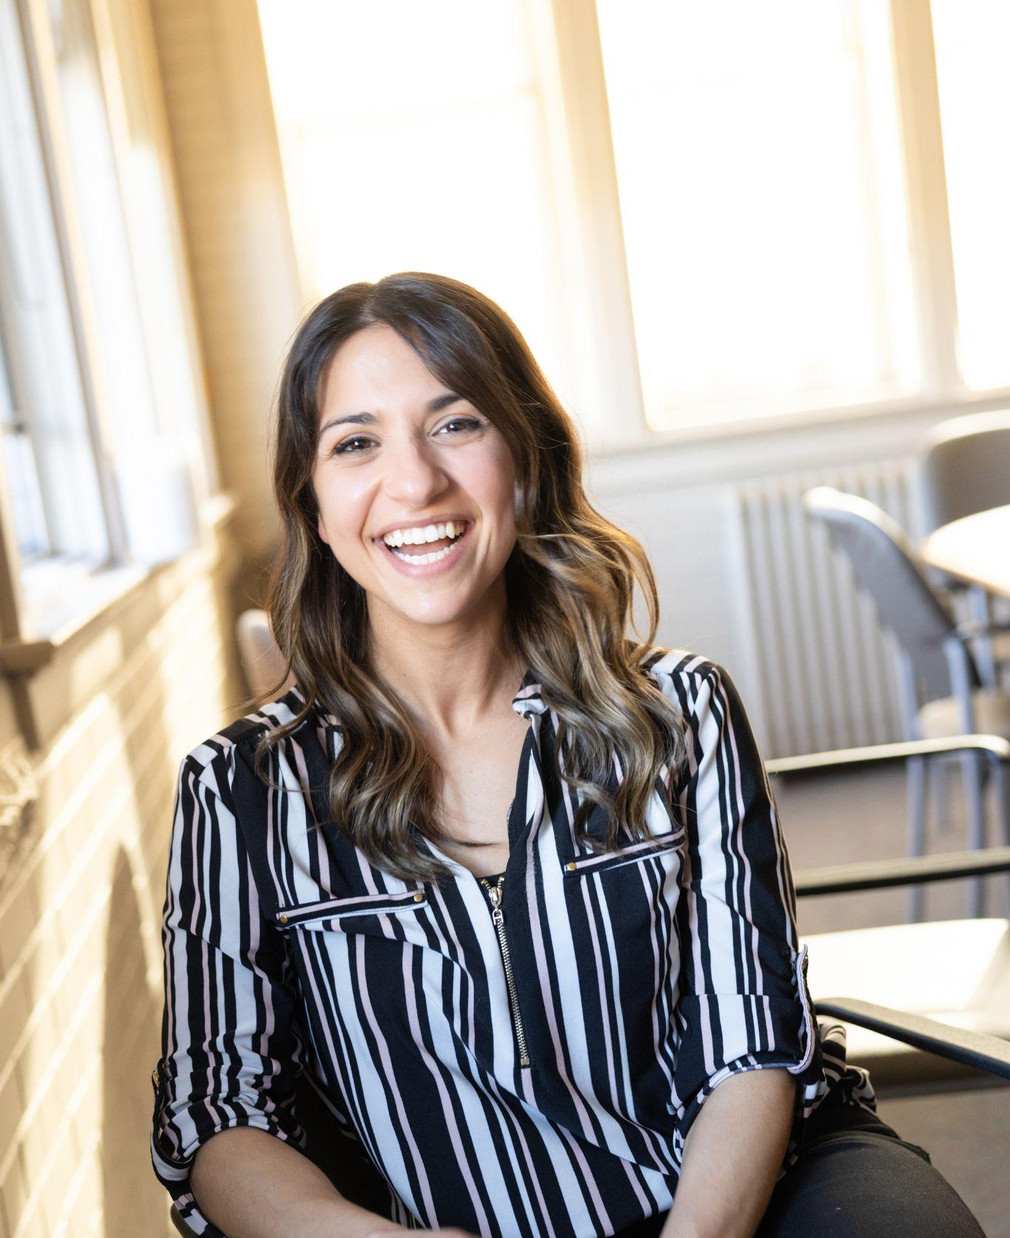
Introductions
Sophia
Music Therapist - GRH Freeport
Registered Psychotherapist
Neurologic Music Therapy Fellow
Focus: Neurorehabilitation and neurodegenerative diseases

Slide 8
Today’s Learning Objectives
Identify 3 ways in which a collaborative program was developed between Recreation Therapy and Music Therapy within Complex Continuing Care (CCC), Rehabilitation (Rehab) and/or Transitional Care (TCU).
Participants will be able to explain 100% of the steps in developing collaborative programs between Recreation Therapy and Music Therapy Departments at GRH
Identify 3 techniques and/or adaptations to apply to clients when facilitating a collaborative recreation and music therapy program within GRH-Freeport campus (CCC, Rehab and/or TCU)
Notes:
Mary

Slide 9
Learning Outcomes
Understand the importance of music therapy interventions within the context of this hospital/organizational setting
Understand the importance of effective collaboration between music therapy and recreation therapy in assisting with patients’/clients’ quality of life (QOL)
Understand and identify the difference between implementing music activities vs. the therapeutic use of music within dementia care, rehabilitation and mental health settings.
Notes:
Mary
Presentation will walk through very technical understanding of how MusicT and RecT modalities impact well being/recovery/QOL for patients/clients
Today we want to give you the what, why and why bother with MT and RecT collaboration, and how that even engages us altogether
Get your thinking caps on, and experience this together with us!

Slide 10
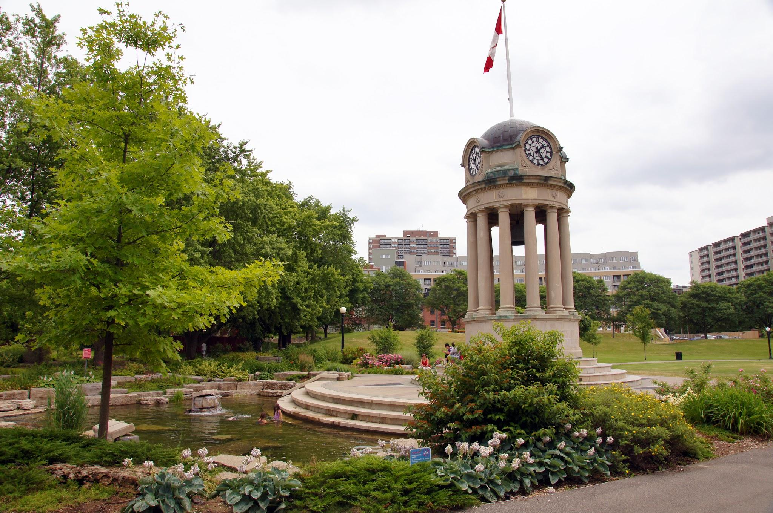
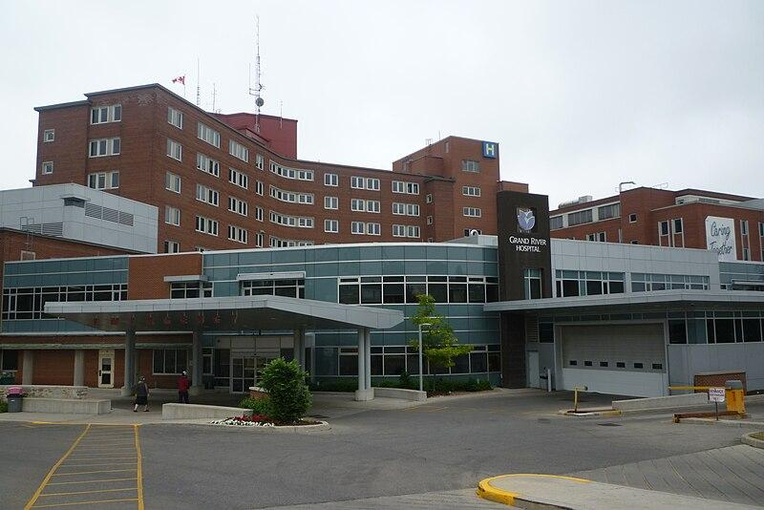
History of Music Therapy and Rec Therapy at GRH - Kitchener-Waterloo (KW) Site
From Community to Hospital Setting…
In 2012 Mount Hope Day Hospital program (MHDP) establishes collaborative partnership with a KW community Music Therapist
Funding supported by GRH Foundations for MHDP
Focus on mental health outpatient (outpt) population and services
Facilitated year long, weekly “Musical Expressions” group
Part of MHDP until services seized due to COVID-19 pandemic in 2020
Inspired other unit programs to include Music Therapy services for clients/patients
Notes:
First proposed by Deborah Seabrook - developed proposal from community practice to hospital setting
Granted by GRH Foundations, funding for MHDP
Aimee Berends and Sarah Pearson continued program - via GRH foundations support
Motivated other areas (CAIP, MH Inpt, Freeport MH) to acquire MT staff
Not all MT’s work with RecT’s and visa versa
MT staffing expands to Freeport
No mental health outpt services collaborations with Music Therapy and RecT currently, just inpts.

Slide 11

History of Music Therapy and Rec Therapy at GRH-Freeport
History from Freeport (Inpt Rehab, CCC, TCU & SMH. MH)
Music Therapy Students
Part Time Music Therapists
Full Time Music Therapist
Collaboration with Rec T
1:1 interventions
on CCC & Palliative
1:1s & trial group programs on TCU
1:1s & multiple group programs across ALL units
*Currently 9 RecT & MT collaborated group programs across GRH-Freeport campus weekly*
Notes:
Melissa
Intermittent Music Therapy Students supervised by Social Work
Provided 1:1 interventions
Part-time Music Therapist’s (MT’s) onboarded during COVID pandemic
Collaboration initiated between Rec T and MT’s
Provided: 1:1 interventions on CCC & TCU group programs
Acquired full time MT’s in past 1.5yrs?
Rec T and MT’s initiated collaboration on all rehab units at Freeport

Slide 12
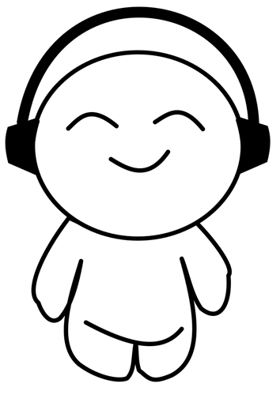
Let’s Begin and take a Listen…
Take a moment right now and listen to this song…get mindful!
Now take a moment and reflect on the music you just heard using the following questions…
What did you notice your body doing?
What did you notice your mind doing?
What did you notice others around you were doing?
Notes:
Play song from iTunes, using speaker [SONG: “Sweet Caroline” by Neil Diamond]

Slide 13
What is Music Therapy (MT)
Music therapy is a discipline in which credentialed professionals (MTA*) use music purposefully within therapeutic relationships to support development, health, and well-being
MTAs use music (live or recording) and therapeutic interventions to address human needs within 7 domains:
Cognitive Emotional Physical Social Spiritual | Musical Communicative
Notes:
Sophia to discuss
Music Therapy is the clinical & evidence-based use of music interventions to accomplish individualized goals within a therapeutic relationship by a credentialed professional who has completed an approved music therapy program. A therapeutic relationship can be developed through music-based, verbal, and/or non-verbal communication.
Certified MTAs use music to address needs within cognitive, communicative, emotional, musical, physical, social, and spiritual domains.
As you can see, there are quite a few domains that overlap with Rec therapy, which is really what makes our opportunity to work together such a success. So who here has ever worked with a music therapist in their careers? Show of hands?

Slide 14

Music Therapy Education
Music Therapists must have:
BA or MA in Music Therapy
Completed a 1000-hour supervised clinical internship
Pass the Certification Board of Music Therapist Exam
Engage in annual continuing education
Additional Certifications are required for specific patient populations
Notes:
Accredited music therapists, MTA, complete a Bachelor or a Graduate degree in music therapy and a 1000-hour supervised clinical internship.
After the internship, a music therapist will write the board exam and participate in continuing education throughout their careers.

Slide 15

Specialities within Music Therapy
Areas/Population of Practice:
Neurological rehabilitation i.e. ABI / TBIs
Alzheimer’s and dementia
Mental health and Substance abuse
Neonatal intensive care
Palliative and end-of-life care
ASD and other pervasive developmental disabilities
Long term and geriatric care
Developmental and physical disabilities
Notes:
As you know, almost everyone will have a positive experience or association with music. Therefore, a lot of individuals will benefit from music therapy. At a high level, these are different areas / populations that music therapist may work with. And today, we review some but not all of these populations.

Slide 16
Music Therapy within GRH
Rehab & Geriatrics Units High Intensity Rehab Program Low Intensity Rehab Program Neurobehavioural Unit Transitional Care Unit | Mental Health Acute Mental Health Specialized Mental health Seniors Mental Health Transitional Mental Health Children & Adolescent Mental Health
Pediatrics Medical Care Pediatric Oncology NICU | Medical Units Complex Continuing Care Palliative Care
Notes:
At Grand River Hospital, we have four music therapists throughout the hospital covering multiple units.
I myself specialize in neurorehab and dementia care, whereas our other music therapists at the hospital works in paediatrics, NICU, and various mental health settings.
The bolded titles are units that we have a combined or collaborative program.

Slide 17
Music Therapy vs Musical Experiences
Music therapy is evidence-based and research-informed.
Certified music therapists (MTA) have specific education on how the various properties of music affect all aspects of health.
Certified music therapists (MTA) set goals and objectives and follow a treatment plan.
The therapeutic relationship between the client and therapist contributes to the change and attainment of goals.
Music is used as a means to meet non-musical goals
Notes:
Sophia to discuss
So throughout the presentation we are actually going to demonstrate some recorded or live demonstrations of music, and then we will work through and talk about how we can make these musical experiences more therapeutic.
But again, just to highlight,
Music therapy is evidence-based and research-informed.
Conducted by a Certified music therapists (MTA)
It’s goal oriented and follows a treatment plan.
And conducted through a therapeutic relationship.
But I think the most the important thing to highlight here is that music is used as a means to meet non-musical goals. So if someone is a musician, or really wants to learn how to play an instrument, or likes to listen to music, right.. Not the most therapeutically significant reason to work with someone. However, if we can use music to assist or meet whatever needs or goals they may have, then we will get involved.

Slide 18
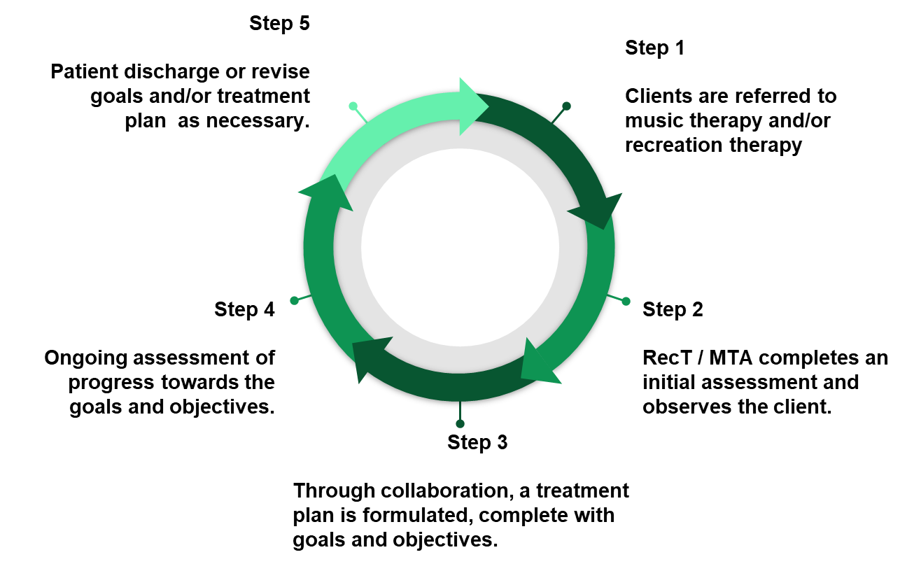
Clinical Process of Music Therapy & Recreation Therapy
Notes:
Sophia starts:
Clinical work involves preparing, implementing, and evaluating music therapy programmes with individuals and groups. The music therapy process frequently begins with a referral from healthcare professionals. The music therapist then completes an assessment through the study of medical or education records, interview of the client and/or family members and, unique to the music therapy assessment procedure, the observation of clients’ responses to music therapy techniques in group and/or individual settings.
Based on this information as well as input from the person, family members and other health care and education professionals, the music therapist formulates goals. These are generally long-term and are achieved in time by the successful completion of smaller and short-term objectives in a group or individual setting. It is these goals and objectives along with intervention procedures and materials that constitute the treatment plan which the music therapist implements.
After implementing the treatment for a reasonable period of time the therapist evaluates the plan to determine whether the methods of treatment are effective and whether the person is making progress in reaching the defined goals and objectives. The treatment plan is modified accordingly. Therapy is terminated when goals have been achieved, the person is discharged from a facility, or when the person can no longer benefit from the services. Throughout the treatment process the music therapist documents assessments, progress, observations, and recommendations regarding the person’s progress. There is ongoing communication between the music therapist and the person who is the recipient of music therapy services, as well as with other members of the interdisciplinary team.
Melissa and Mary chime in with casual information (How TR APIE process takes place here also)

Slide 19
Shared Music Therapy (MT) and Recreation Therapy (RecT) Goals
Improve seating and activity tolerance
Improve communication and appropriate social interactions
Provide structure and meaningful engagement
Enhance daily living in an individual or group setting
Promote communication and self-expression through singing, and active music making
Improve mood and increase energy

Slide 20
Shared Music Therapy (MT) and Recreation Therapy (RecT) Goals
Encourage physical movement through active music making
Decrease stress and agitation through predictable, pleasurable experiences
Decreased anxiety and agitation
Increase alertness and orientation to environment
Enhance cognition and memory recall

Slide 21
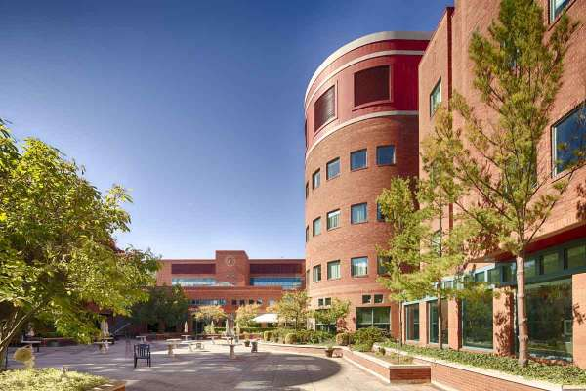
Purpose and Relevance in GRH - Freeport population
Offer more individualized, goal focused interventions using Music Therapy, Psychotherapy and Rec Therapy approaches
Allows for individual’s to recognize, appreciate and evaluate their strengths and abilities
Assists with recovery, and/or acceptance
Notes:
Melissa?
So why does all of this matter?
Ultimately, we are able to assist in providing a more holistic approach to patient care. The client’s have room to move through their disability with us. So for example, I have worked with Music Therapists wherein we have witnessed someone move their foot for the first time with us or be able to string together words in order to sing Happy Birthday to his wife.
Collaboration between Rec T and Music T at Freeport offers these individualized, interventions plans, allowing for the recognition, appreciation and evaluation of everyone’s strengths and abilities. By collaborating, we are assisting with our client’s recovery or their acceptance of what the next steps in their life can look like.
As we go through this presentation, our videos will exemplify this.

Slide 22
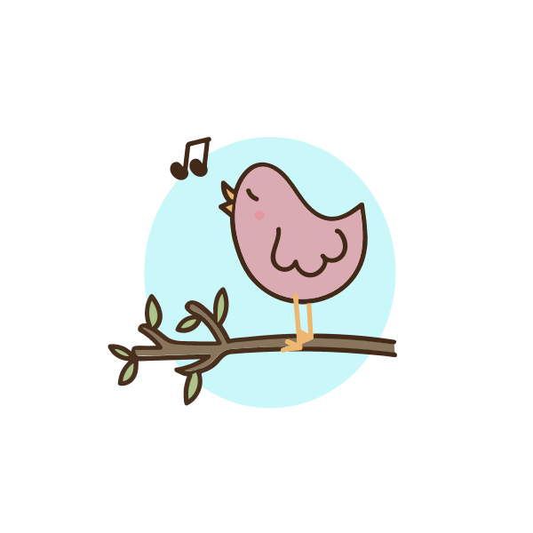
Let’s Think - Activity #1
Listen to this song, and sing-along if you know it!
Notes:
Sophia plays a song - used in older adults population [LIVE MUSIC via guitar/piano] - hey good looking… let’s pretend we are going for a picnic, what do you plan to bring? Lyric replacement. This will then lead to reminiscing and group discussions…. Schneider red hots

Slide 23
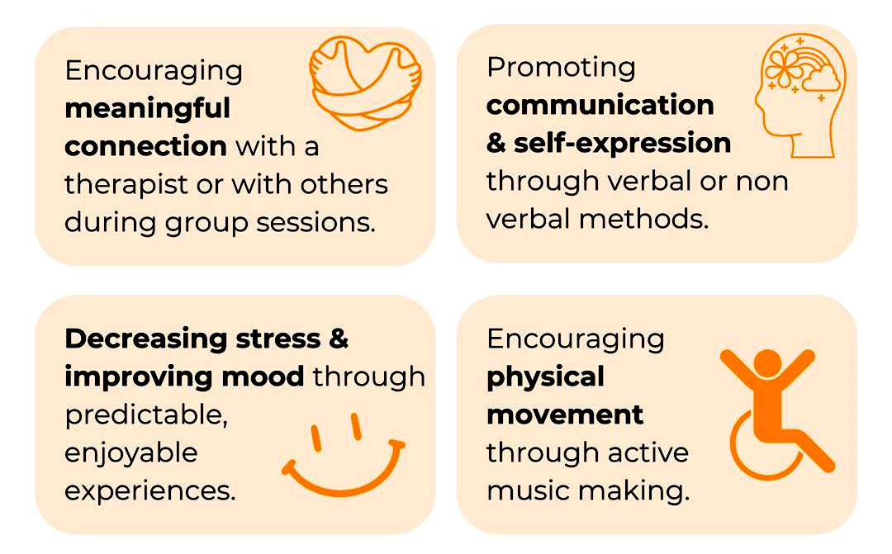
Role of Music Therapy in Dementia Care
A holistic approach that relies on individual strengths and needs to positively impact mood, behavior, cognition and mobility. This is achieved by:
Reference: https://www.instagram.com/p/C7AOBI0Jc5M/?hl=en
Notes:
A holistic approach that relies on individual strengths and needs, positively impacts mood, behavior, cognition and mobility.
Music therapist will always use familiar songs and positive associations to promote cognitive awareness, attention, and executive functioning skills. This may include music from their younger years or significant events (such as their wedding), which encourage them to evoke involuntary autobiographical memories.
Additionally, music therapists (MTA) use music to create a social environment for dementia clients who may be withdrawing from peer interaction
Music therapy is used to provide structure and meaningful engagement for those who can no longer participate in other therapeutic opportunities due to confusion and/or increased agitation in group settings

Slide 24
Why it works - Music & The Brain
Benefits of Music Therapy
1. Trigger emotions and promote the creation of new neurons in the brain and help improve memory and mood in people living with Dementia
2. Activates the brain’s reward system and releases dopamine, a neurotransmitter that may help reduce age-related cognitive and motor decline
3. Reduce stress and help regulate the immune system, which may reduce the rate of neurodegeneration in Dementia
Notes:
WHY it works — Music interventions have grown in popularity as a method of non-pharmacological treatment for those experiencing Alzheimer’s or other forms of dementia. For many patients, approved drugs will provide little benefit for symptom management.
Music works because musical perception is processed throughout the entire brain, activating all areas of brain tissue during when listening to music and actively participating musical interventions.
Musical memories, therefore, are stored throughout the brain and is still accessible even in the late stages of memory disorders. Most individuals have a strong relationship with music, which allows for people to associate autobiographical memories and musical memories together, which will remain intact until later stages of AD.
Additionally, music stimulates the use of synaptic connections between neurons and specialized areas of the brain, which may otherwise remain dormant and lose function if they are inactive.
It’s important to note that music cannot reverse the loss of cognitive function, but it can maximize the existing function.

Slide 25
Recreation Therapy & Music Therapy In Dementia Care
Units include:
Neurobehavioural Unit/Geriatric Assessment Unit (NBU/GAU)
Transitional Care Unit (TCU) - Alternative Level of Care
Complex Continuing Care (CCC) Unit
Targets:
Behavioural management Reminiscence Delirium prevention | Movement & activation Socialization Meaningful engagement
Notes:
MARY
At Freeport, Rec T and Music T collaborations in dementia care are facilitated on our Neurobehavioural/Geriatric Assessment Unit (NBU/GAU), Transitional Care Unit - Alternative Level of Care, and Complex Continuing Care Unit.
The main focus of Rec T and Music T collaborations on these units include: behavioural management, reminiscence, delirium prevention, movement and activation, socialization and meaningful engagement.

Slide 26
Music Therapy & Recreation Therapy Programs @ Freeport
TCU
CCC
GAU/NBU
Music & Movement x2
Reminiscent
Choir
Multi Modal Sensory Stim, Pain Perception & Relaxation
Behavioural management & emotional regulation x2
Notes:
SOPHIA STARTS:
A joint therapeutic program designed to reduce responsive behaviours for patients experiencing behavioural and psychological symptoms of dementia. Through the use of specific music therapy interventions, patients will be encouraged to participate in musical activities to promote cognitive awareness, attention, and executive functioning skills. Patients are encouraged to participate in musical activity, while engaging in appropriate social interactions. Studies have shown that music therapy has been effective in reducing BPSD (2015). Research on music therapy in the treatment of memory disorders has shown to:
Decreased depression, anxiety and agitation
Increase alertness & orientation
Enhance cognition & memory recall
Improve communication & appropriate social interactions
While it looks like I may just be playing music to others, I use specific songs that a patient will relate to or have a strong memory associated with it, and then create interventions within these familiar songs. For example, going back to “hey good looking” I’m asking individuals to think on the spot and come up with an example that fits within the context of the song. It can actually be quite difficult to work out.
MARY NEXT:
TCU
MELISSA:
On CCC we offer a weekly unit-based program wherein the program itself is more passive, with the focus being on reducing pain perception and improving relaxation, while still offering opportunities for use of musical instruments. For example, we have 1 client who unfortunately has no functional movement, limited cognition, an inability to use her voice and experiences pain. However, we know that this individual LOVES TAYLOR SWIFT, so we use hand over hand touch on an ocean drum while the music Therapist plays a hit of Taylor’s. The client then gets to feel the vibrations of the ocean drum which elicits a non verbal response such as opening her eyes, big smile and focused attention.

Slide 27
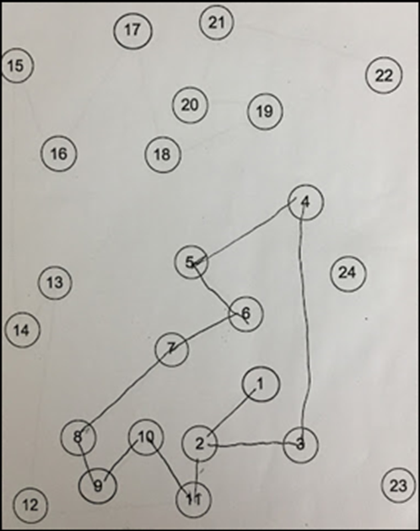
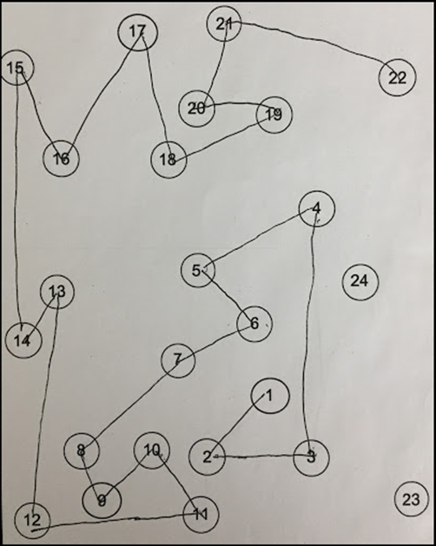
Example of the benefits - Musical Executive Function Training
Notes:
So here, I just wanted to showcase the impact of music therapy in a behavioural wandering unit. In this example, an individual with progressed dementia participated in this trail making test. In the first example, we see that within 3 minutes, this individual completed 1 - 11 (with a few mistakes). They then engaged in a 30 minute music therapy group focusing specifically on attention and executive functioning skills. Immediately following the session, this patient recompleted the trail making test, and within the same time frame, they were able to complete 1-22, showing an immediate improvement in cognitive skills.
So we know that music can make us think… but, how does it make us move?

Slide 28
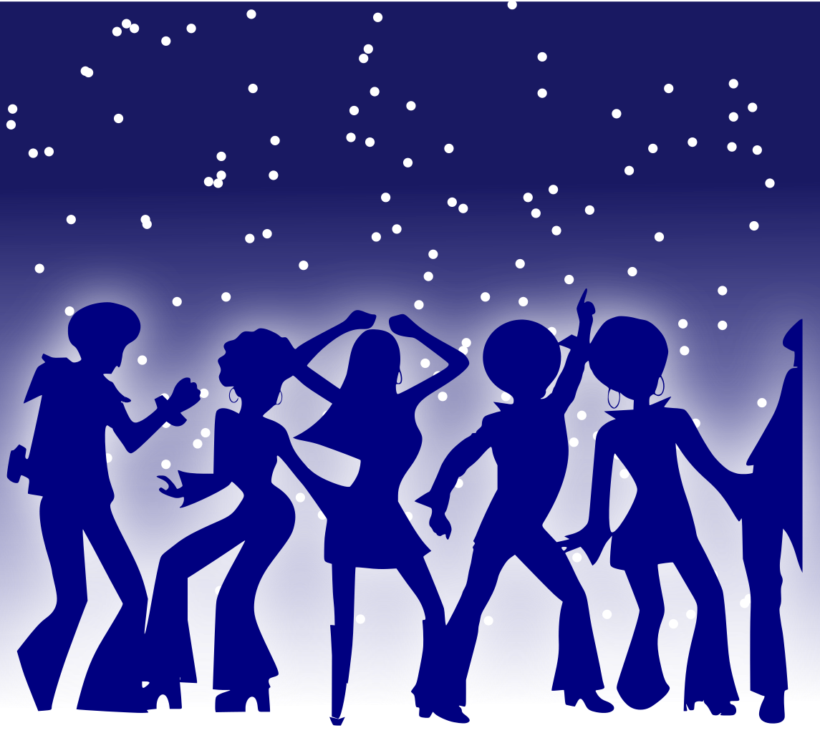
Will You Move to this? - Activity #2
Ready…
Set…
Listen…
DANCE?
Notes:
[Play “YMCA” by the Village People] —--> Quick Debrief - Notice how you moved? Which body part moved first?

Slide 29
Role of Music Therapy in
Rehab Care
An in interdisciplinary and collaborative approach to promote neuroplasticity and psychosocial wellbeing.
Often achieved by the use of live music and/or musical activities
Video recording remove
Notes:
An interdisciplinary and collaborative approach to design treatment aimed at facilitating experience-driven neuroplasticity and psychosocial wellbeing. This is often achieved through the implementation of live music and/or musical activities. Music therapists that are working in rehab units are should be trained as neurologic music therapists.

Slide 30
Working Mechanisms
Rhythmic Stimulation and Entrainment
Patterned Information Processing
Differential Neurologic Processing
Affective Aesthetic Response: Arousal, Motivation, and Emotion
Notes:
So before we get into talking about music therapy in rehab, lets quickly talk about how complex music really is. Music is one of the few interventions that actually stimulates our whole brain simultaneously. Let’s think about it – when we listen music we utilize our auditory cortex, our prefrontal cortex is breaking down and understanding music, we often find our cerebellum or motor cortex activated because, who really can’t move to music? And I am sure that majority of the people in this room can’t help but sing or hum along to a song, activating our speech areas in the brain… wow, what a work out!
So because many different areas of the brain are engaged at the same time, we have these four processes that are happening simultaneously. Our brains are processing the rhythm involved, our brains are processing patterns within music, our brains process each aspect of music differently, and of course, it is aesthetically pleasing and often creates an emotional response. These four working mechanisms is also what drives neurologic music therapy and helps to promote neuroplastic change in the brain.

Slide 31
What is Neurologic Music Therapy?
Neurologic Music Therapy (NMT) uses the elements of music to promote neuroplasticity and improve functioning in the following domains:
Cognition
Speech and Language
Sensorimotor
NMT is an evidence-based practice based on neuroscientific models of music perception and production
Music and instrumental playing are used to assist in the recovery of function post-stroke and/or other neurologic conditions.
Notes:
Cognition domain uses music to increase attention, executive function skills, organization, etc. For this domain, we might use a songwriting technique… for example, circling back to the demonstration of “hey good looking” can we have a patient find phrase or an item that fits within the context of the song - we use this a lot in our dementia work. Or for example, if we want to promote or increase attention post stroke…I may play the song, Country roads and ask a person to track how many times the words “Mountains” and “Roads” appear in the song.
Speech & Language: uses music to stimulate or restore lost speech.. I will often use these techniques when working with an aphasic stroke patient to bring back speech. We can use this is many ways, perhaps I take a overly familiar song, such as you are my sunshine, and have them complete the phrase. Activating their automatic speech For example…. “You are my sunshine, my only ….” - you can’t NOT complete the phrase.
Or, if we want to promote the use of functional phrases, I may take a statement and pair it to a melody. For example, let’s sing: Thank you very much. Post stroke, individuals will be able to sing the functional phrase before speaking it… so we can sing it a few times, and then eventually take away the melody. What’s left is just phrase.
Sensorimotor rehab: therapeutic use of music (rhythm, for example) or instrument playing to stimulate functional movement patterns. This may include instrument playing or even just movement to music. For the purpose of this presentation, we are going to focus on sensorimotor rehab which will become clear in the following slides.

Slide 32
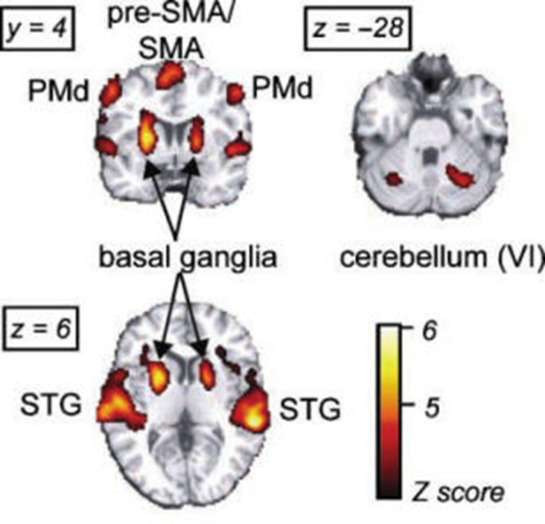
The Power of Rhythm
How we move vs. When we move
What is entrainment?
How do we process rhythm?
Notes:
When we hear music, we’re moved. It doesn’t matter what we hear, it doesn’t matter what type of music, but there’s something innate in us that makes us want to move. We can tap our feet, clap our hands, sway out bodies. This is because of the rhythm that’s in music, and depending on how that rhythm is presented, it will make us move. For example, when we hear **guitar marching** vs. **guitar waltz** … we might move a little differently.
Perfect! So as you can see, it’s quite easy to fall into music’s rhythm. Our bodies and mind crave rhythmical information. We walk rhythmically, we talk rhythmically, we think in a rhythmic structure. So when a rhythm is available, without knowing, we actually start to walk and move to that beat. This idea of falling into rhythm is what we call entrainment.
So let’s do a quick demonstration. I’m going to simply play a beat on this metronome. Can everyone try to tap along to this peat with their finger? MARY, can you please put a metronome on at 90 BPM? As people are tapping, slowly increase the speed by 2 bpm, wait 10-15 seconds, increase, wait, increase…. Then show the difference between 90 and 100?
This idea of entrainment is innate in humans. Thaut et al, 2002 demonstrated that individuals subconsciously changed their motor patterns when an auditory stimulus was increased incrementally. So it becomes this unconscious involvement, where our body is naturally motivated by the rhythmic cuing. There’s actually research showing that the more we think about entrainment, the more we psych ourselves out – isn’t that funny?
Now it’s hard to understand where entrainment ‘lives’ in our bodies, but some recent research, including Jessica Grahn 2000 in Toronto), has demonstrated that our internal cueing system starts at the basal ganglia and goes back to the cerebellum and onward to the motor cortices. The basal ganglia is also the part of the brain that is responsible for controlling voluntary movements.
In addition to this neural process, a consistent beat will also activate our central pattern generators. Our CPGs are responsible for rhythmical movements, such as walking, or our arm swing.
So after a stroke or a neurodegenerative disease, if our motor area of the brain is impacted, we can flip on a beat and our CPGs will automatically entrain to this beat. So even if the area of the brain is damaged, we will often see an automatic entrainment to the beat. This works especially well in stroke rehab, as well as parkinson’s disease to eliminate shuffled gait or freezing of gait.

Slide 33

Example of Neurorehabilitation Goals
Neurologic Music Therapy can help to:
Improve walking patterns and symmetry of gait post-stroke through RAS
Improve gross/fine motor through playing instruments
Improve speech clarity and articulation
Improve respiratory strength and projection
Restore expressive language due to aphasia
Enhance attention and executive function
Improve visual scanning of neglected field
Reduce feelings of anxiety & depression
Support coping strategies post-stroke
Notes:
So here is a quick summary of music therapy neuro rehab goals… as I list these, can you reference any similiar goals?
So we can have people walk to a beat….
geriatric population experiencing COPD, or those with PD, we can use vocal exercises, or even wind instruments to improve resp function, strength, projection, articulation, etc.
Post stroke, improve visual scanning or attention to the neglect side, by having people play an instrument just outside of their perceived visual field.

Slide 34
Meet Tom
57 yr old male, ischemic strokes
Disciplines involved: PT, OT, Rec T, MT
Focus: Motor rehabilitation, resp support, psychosocial support
Video recording remove
Notes:
On May 5 he underwent a scheduled Ross procedure [aortic valve replaced with patient's pulmonary valve, pulmonary valve replaced with pulmonary allograft]. Postoperative complications included sternal osteomyelitis and left occipital and right temporoparietal ischemic CVAs. Transferred to inpatient rehab on June 9, 2023. After completing his inpatient rehab, he returned home and was admitted to our outpatient neurorehab clinic.
While inpatient, he was involved in OT, SLP, PT, Rec T and Music T. VERY limited movement at the start. Was unable to sit up in chair, etc.

Slide 35
Client Example - Tom
Video recording remove

Slide 36
Recreation Therapy & Music Therapy in Rehab
Units include:
General Rehab
Low intensity Rehab
Neurorehab Outpatient Clinic
Targets:
Functional skills & activity tolerance Adjustment to disability Mood, coping, & socialization | Enhanced respiratory functions Introduction or re-engagement in meaningful activities
Notes:
*Mel to start & Soph to describe programs after Mel*
General Rehab a.k.a high intensity rehab, known as our stroke unit, however population also includes individuals with an ABI or spinal chord injuries. On this unit, individuals receive OT, PT, SLP, plus 2 TA led group programs daily. Rec T and Music T are additional sessions.
Low Intensity rehab- I like to explain this unit as our older adults (grandma and grandpa’s) who have fallen and fractured or broken a hip, leg arm etc; or individuals who were failing to cope at home (multiple falls etc). This unit receives max of 2 therapy sessions- OT and PT daily for 30mins.…for the most part these individuals receive 1 30mins session daily. Rec T and Music T are additional.
The Neurorehab clinic is our outpatient program wherein individuals from the community with a sub-acute neurologic diagnosis are referred. Many of our patients who are discharged home from our inpatient general rehab unit are referred here for continued rehab. INdividuals receive a max of 24 sessions per discipline in this clinic.
Our collaboration between Rec T and Music T on these units target areas such as functional skills, activity tolerance, mood and adjustment to the individual’s disability

Slide 37
Back to Tom!
Video recording remove
Notes:
Soph-Here Tom is using the elements of music to stimulate a movement pattern.
Mel?- The focus on Tom has been predominantly on his physical or functional skills training. However, Music T and Rec T does also play a role in how it affect our mood and feelings. Tom, as you will see at the end of our presentation, demonstrates how Rec T and Music T also help to support his mood throughout his rehab journey with us at Freeport.

Slide 38
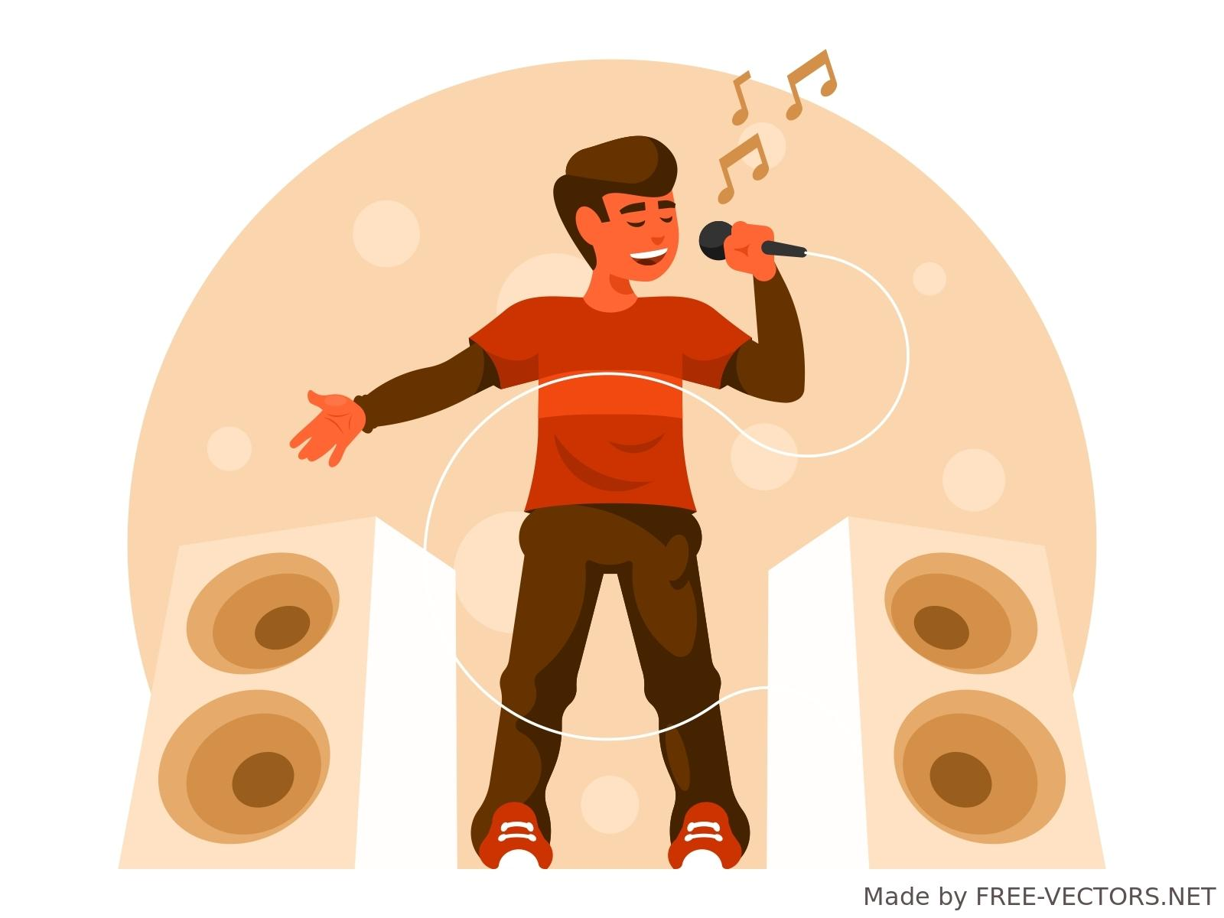
Can You Feel It? - Activity #3
Do you know this tune?
What feelings did it bring to you?
Notes:
[Play “You’re my Inspiration” by Chicago] - Quick Debrief —-->What emotion did this elicit? When would you play a song like this?

Slide 39
Role of Music Therapy in Mental Health
The specialized use of music to restore, maintain, and improve cognitive, emotional, social, communicative, and physiological functioning (AMTA, 2015).
The use of goal-directed music interventions focused on symptom management , foster relationships, and provide psychosocial support.
Provide education and training to assist with grounding techniques and mental health education
Music therapists must be recognized as a Registered Psychotherapist
Notes:
The specialized use of music to restore, maintain, and improve cognitive, emotional, social, communicative, and physiological functioning (AMTA, 2015).
The use of goal-directed music interventions focused on symptom management, fostering relationships with peers and therapists, and providing psychosocial support and education to augment hope, meaning, purpose, and recovery.
Provide education and training to assist with grounding techniques and mental health education
To practice in music therapy in mental health settings, music therapists must be recognized as a Registered Psychotherapist
When added to standard care, music therapy can improve the global state, mental state, social functioning, and quality of life of people with schizophrenia or schizophrenia-like disorders (Geretsegger et al., 2017).
Music therapy can decrease anxiety and improve depressive symptoms and functioning of people with depression compared to treatment as usual (Aalbers et al., 2017). ♦ Music therapy can result in beneficial outcomes on emotion, motivation, participation, locus of control, and perceived helpfulness for adults with substance use disorders (Hohmann et al., 2017)
Music therapy has a strong positive effect in enhancing contemplation, treatment readiness, motivation, and cravings in addiction treatment (Megranahan & Lynskey, 2017).
Single music therapy sessions can be as effective as single verbal therapy sessions for various psychological outcomes with higher music therapy scores for comfort, therapist-rated working alliance, and change readiness for adults with substance use conditions (Hohmann et al., 2017).

Slide 40
Music Psychotherapy Education
At GRH, all music therapists are also Registered Psychotherapists (RP).
RPs must:
Have completed a relevant graduate-level degree
Pass a registration exam and complete at least 1,000 hrs of direct contact with clients and 150 hrs of clinical supervision
Participate in annual Continuing Competency program and continuing education

Slide 41
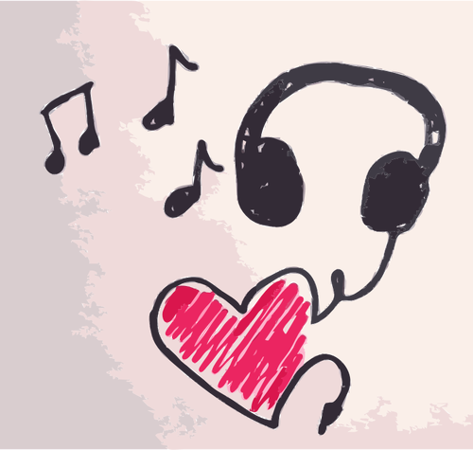
Music Therapy in Mental Health
Reduce depressive symptoms, decrease anxiety, and improve functioning for people with a variety of mental health conditions
Improve emotional expression, group interaction, development of skills, and quality of life for people with substance use conditions
Improve therapeutic alliance, treatment eagerness, coping skills, locus of control, change readiness, and craving in adults with substance use conditions
Address loneliness, grief, loss, and stigma that persist despite treatment

Slide 42
Recreation Therapy & Music Therapy in Mental Health
Units include:
Specialized Mental Health - Seniors Program
Specialized Mental Health - Adults Program
Hospital wide
Targets:
De-escalation Activity tolerance Mood & socialization | Adjustment to disability Introduction or re-engagement in meaningful activities
Notes:
Mary - speak to MH staff

Slide 43
Applications of Music - Iso Principle Playlist
Song Title & Artist | Effect of Song
Feel this moment – Pitbull & Christina Aguilera | Reminds to live in moment, vacation, gratitude
Smile – Kirk Franklin | Hope, acknowledges pain & sadness but can make it through.
True colours – Cyndi Lauper | I have to figure it out, became tough because the change. Made me a resilient person.
Mr Boombastic – Shaggy | Silly, fun, in the moment, not taking self too seriously
ABCDEFU - Gayle | Mad, feels good to get it out, it’s unfairness, I’m not angry, starting point
Fast car - Luke Combs | Starting sad, but there’s a plan to go to the next thing… take the problem and move on… moving forward. A the beginning.
Brick House – Commodores | Relaxed, slow, calmer, positive memories
Hallelujah – pentatonix | Near the beginning, faith is important, put my worries for God to take care of, acknowledging the current problem.

Slide 44
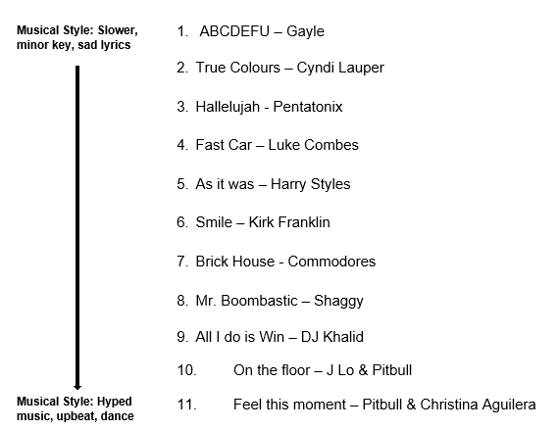
Applications of Music - Iso Principle Playlist
Purpose of my playlist? De-escalation
Starting Emotion: Sad, frustrated, Overwhelmed
Ending Emotion: Energized, Empowered
Notes:
PMR demonstration?? If time?

Slide 45
Ideas to developing collaborative programs
Formal processes vs. Organic collaborations (informal)
Formal Processes | Organic/Informal Collaborations
Grant proposals and review of literature (submitted to Foundation) Client Needs Assessment - development, implement, evaluate Program development - collaboration w/ Music Therapist Facilitation of collaborated program Evaluation of collaborated program | Take initiative Review client and program goals to ensure alignment Peer-Peer learning Seek resources Trial & error Evaluate and revise
Notes:
Mary: This is the ‘why bother’ portion of our presentation and in understanding the process that we underwent to have the current collaborations we have —--> use MHDP process, formal, structured, but outcomes were organic and outcome-based
Melissa:
Take the Initiative- put yourself out there and ask to collaborate. Both Sophia and I met each other with the same energy,work ethic and drive for person centered care, but it took a friendly “Hey, what are your thoughts about this?” and then a larger discussion on the client’s goals.
Informal collaboration also allows for building more trusting relationships and rapport with the clients. When the clients see how our shared vision and goals align, we notice our client-therapist relationship and rapport start to strengthen.
Through informal collaboration we also gain “on the spot training.” Sophia is able to provide me with specific instruction on how to use Music Therapy modalities throughout our joint interventions, while I am able to offer Sophia key interests about the client to inform how the program can be tailored for more meaningful engagement.
Informal collaboration also leaves the door open for trial and error. It allows for flexible or spontaneous interventions based on the individual or the client population.
It also means constant evaluation and revision to ensure you are providing the most meaningful approach to your client’s care.

Slide 46
How to find a music therapist
Canadian Association of Music Therapists: https://www.musictherapy.ca/directory-of-certified-music-therapists-mta/
Music Therapy Association of Ontario: https://musictherapyontario.com/find-a-therapist/
The Academy of Neurologic Music Therapy: https://nmtacademy.co/find-an-nmt/

Slide 47
Take Out and Take Aways…Next Steps
Collaboration enhances client’s ability to progress towards or achieve the client’s goals
Diversified programming for clients in our organization
The sum is greater than it’s parts!
Collaboration enhances:
communication and inclusivity
boosts productivity and efficiency and
allows for innovation and problem solving
Notes:
So what can we take away from the last 90minutes of us 3 just spewing information up here?
Well, I think we have shown how ongoing collaboration between Rec T and Music T assists in the progression or achievement of client’s goals- Tom is a great example of this.
It has allowed for multiple different/diversified programs, 9 to be exact at Freeport.
The sum really is greater than it’s parts!
Collaboration has leveraged and amplified Rec T and Music T’s ability to assist the client in providing more possibilities for recovery or engagement compared to separately facilitating.
Now from a larger organizational standpoint…
Collaboration enhances communication & inclusivity
When we have shared goals, it allows for us as a care team to share in a holistic vision to deliver better pt care
- Collaboration boosts productivity and efficiency
Our jobs at the hospital depend largely on funding, which is driven by productivity and the # of pt’s we see per day. In collaborating, we are able to reach multiple clients at the same time to provide/deliver interventions with those who have the same/similar goals.
Collaboration allows for innovation and problem solving
2 heads are better than 1!
By working together, we can more effectively explore innovative ways to assist with client care during their hospital stay

Slide 48
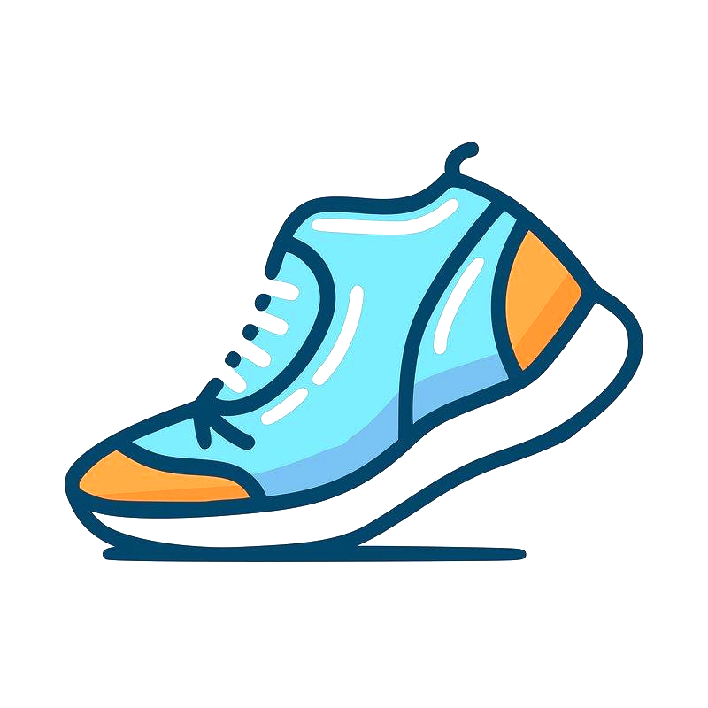
“It’s worth it.”
-Tom
Video recording remove

Slide 49

Q & Eh!

Slide 50

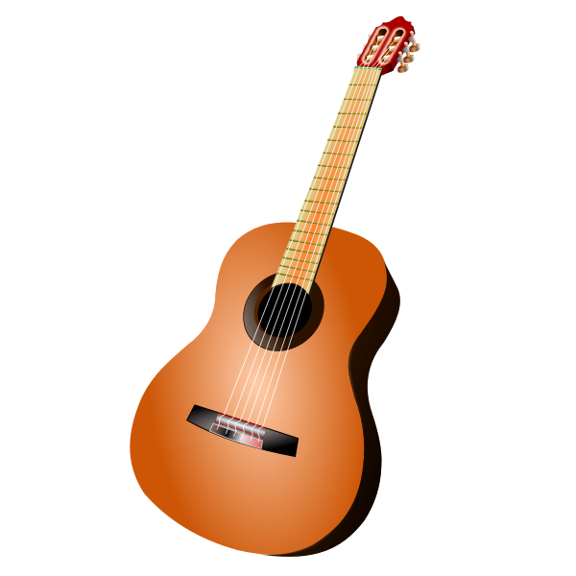
Thank You!
That’s all folks!
Grand River Hospital - Freeport, Kitchener, ON
519-749-4300
Mary Afable, x7842
Mary.afable@grhosp.on.ca
Sophia Christopher, x7008
sophia.christopher@grhosp.on.ca
Melissa Tennant, x7277
melissa.tennant@grhosp.on.ca

Slide 51
References & Resources
Grahn JA, Brett M. Rhythm and beat perception in motor areas of the brain. J Cogn Neurosci. 2007 May;19(5):893-906. doi: 10.1162/jocn.2007.19.5.893. PMID: 17488212.
Stephan, K. M., Thaut, M. H., Wunderlich, G., Schicks, W., Tian, B., Tellmann, L., Schmitz, T., Herzog, H., McIntosh, G. C., Seitz, R. J., & Hömberg, V. (2002). Conscious and subconscious sensorimotor synchronization—Prefrontal cortex and the influence of awareness. NeuroImage, 15(2), 345-352. https://doi.org/10.1006/nimg.2001.0929
Thaut, M. H., & Hoemberg, V. (Eds.). (2014). Handbook of neurologic music therapy.
Thaut, Michael. Rhythm, Music, and the Brain. 1st ed. Taylor and Francis, 2013.
Healthline. (n.d.). Music for dementia: How does it work? Healthline. Retrieved June 3, 2024, from https://www.healthline.com/health/dementia/music-for-dementia#how-does-it-work
American Music Therapy Association. (2021). Music therapy and dementia care: Fact sheet. American Music Therapy Association. https://www.musictherapy.org/assets/1/7/factsheet_music_therapy_and_dementia_care_2021.pdf ​
American Music Therapy Association. (2021). Music therapy for adults with mental health and substance use conditions: Fact sheet. American Music Therapy Association. https://www.musictherapy.org/assets/1/7/FactSheet_Music_Therapy_for_Adults_with_Mental_Health_and_Substance_Use_Conditions_2021.pdf

