Slide 1

Death Cafe
Lyndsey Charles
Janet Newbigging
Olivia Rizzi

Slide 2
Lotus Bloom Resilience Exercise

Slide 3
Background History
Death Café model was founded by Jon Underwood and also developed by Sue Barksy Reid.
The model was inspired by sociologist Bernard Crettaz who facilitated Café Mortel events in France and Switzerland.
Underwood’s objective was to host gatherings for people to openly speak about death with the ultimate objective of “'to increase awareness of death with a view to helping people make the most of their (finite) lives”.
The first Death Café was hosted in September 2011 in Jon’s House in East London, UK.
Since then, it has quickly spread across Europe, North America, Australia and Asia.
There have been over 18,000 Death Café’s offered in over 89 countries since 2011.
(St. Mary’s University, 2024)

Slide 4
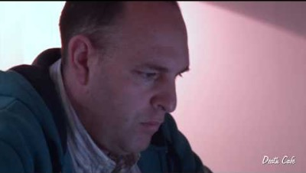
About Death Café from Jon Underwood
(Death Café, 2017)
Notes:
https://www.youtube.com/watch?v=S1zb6LKVg6o
Link for Above Video (approx. 3 minutes)

Slide 5
Standard Rules of the Death Cafe
Provided on a not-for-profit basis
Do not lead people to any conclusion or course of action/no answers or any solutions
Very respectful of other opinions and beliefs
Always provide refreshments

Slide 6
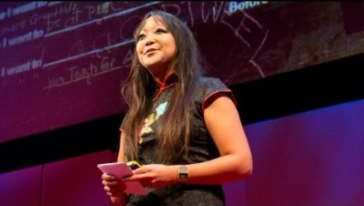
Before I die I want to . . .
(TED, 2012)
Notes:
https://www.youtube.com/watch?v=uebxlIrosiM
Link to Ted Talk above.

Slide 7

Before I die I want to . . .
(TED, 2012)
This Photo by Unknown Author is licensed under CC BY-NC
Notes:
Reflective Exercise

Slide 8
Talking about death won’t kill you.
Notes:
Here we can initiate the “Death café Conversation” starter questions!

Slide 9



Book Recommendations

Slide 10

Related Resources
Follow on Instagram:
Celizabethdougherty
Talkdeathdaily
Agooddeathfilm
death.ambassadors
100% Certainty Project
talkaboutdeath.ca
thedeathdeck.com
(Grief Refuge, n.d.)
Home - ACP in Canada | PPS au Canada (advancecareplanning.ca)
Notes:
Let’s talk about these resources

Slide 11

“Death is not the opposite of life, but a part of it.”
- Haruki Murakami
Notes:
End the Death Café with a quote*

Slide 12
References
Death Café. (2017, October 27). About death café by founder, jon underwood. [Video]. Youtube.
https://www.youtube.com/watch?v=S1zb6LKVg6o
Grief Refuge. (n.d.). Peace and purpose after loss.
https://www.griefrefuge.com/
St. Mary’s University. (2024). The art of dying well.
https://www.artofdyingwell.org/founder-death-cafe-died/
TED. (2012, September 4). Before i die i want to…[Video]. Youtube. https://www.youtube.com/watch?v=uebxlIrosiM
Impermanence. (2016). Death café.
https://deathcafe.com/gallery/resource/

