Slide 1


WORDS MATTER: WHAT IS YOUR ROLE IN PERSON-CENTRED LANGUAGE?
Courtney Stasiuk-Mohr, Project Specialist
Behavioural Supports Ontario Provincial Coordinating Office,
North Bay Regional Health Centre
Esther Russell, Project Manager
Ontario Centres for Learning, Research and Innovation
at the Schlegel-UW Research Institute for Aging
TRO 2024

Slide 2


Acknowledgements
The Person-Centred Language initiative and resources have been co-developed by BSO and the Ontario CLRI at the RIA with support from an expert panel.
This work is supported in part with funding from the Government of Ontario through the Ontario CLRI and BSO. The views expressed herein do not necessarily reflect the views of the Province

Slide 3
Key Learnings
By the end of the session, attendees will:
Identify 3 effects that PCL has on documentation and implementation
Identify 3-5 PCL champions within your organization to support PCL implementation
Develop an action plan for your organization to further implement PCL initiatives

Slide 4
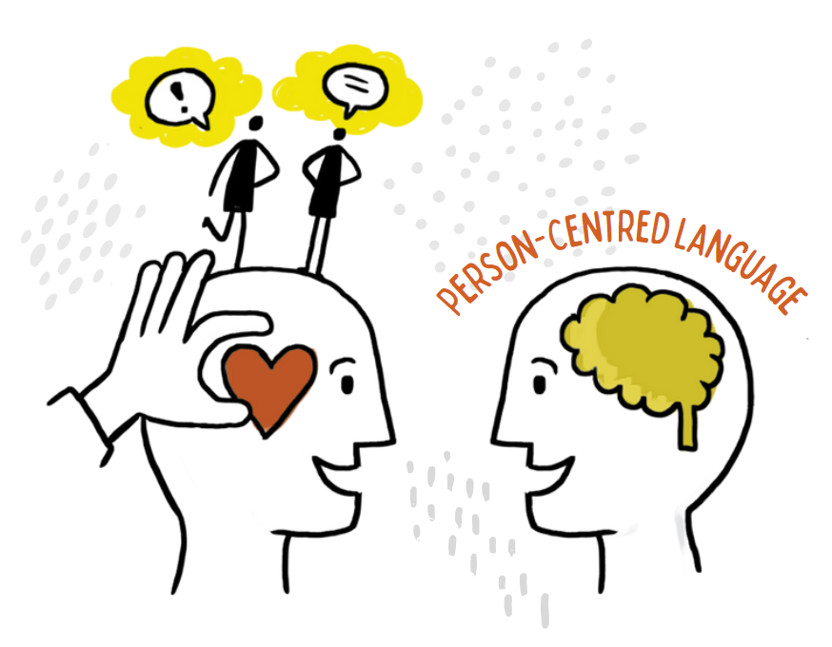
What is Person-Centred Language (PCL)?

Slide 5

Person-Centred Language
Person-centred language (PCL) refers to using language that puts people first rather than the disease, symptoms or conditions that they may have.
This means focusing on the strengths and abilities people have, rather than their disabilities.

Slide 6

Getting to Know You
Where are you on your PCL Journey?

Slide 7
Why do we need PCL?
Stigma and discrimination
Stereotypes, labels and prejudices
Misunderstandings and misconceptions
Decreases
Feelings of shame, guilt, fear and distress
Social isolation
Negative, inaccurate and misleading portrayals across society

Slide 8
Why do we need PCL?
Discussions around health promotion and prevention
Promotion of positive views in mass media
Understanding through education
Quality of life and well-being
Participation in research
Increases
Living at home and staying involved in the community and at work
Leveraging strengths and abilities
Pursuing a timely diagnosis and support
Sharing personhood facts and symptoms being experienced

Slide 9
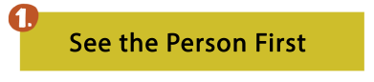
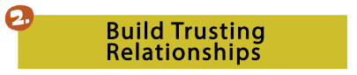



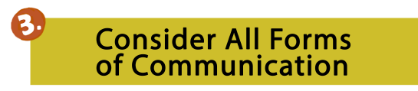

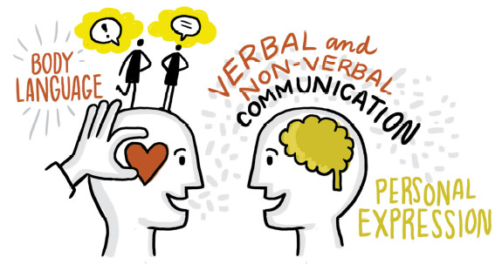

Principles of PCL

Slide 10
Group Activity
Sharing Stories:
How has language impacted experiences positively or negatively?

Slide 11

Building a PCL Community
Roles of team members, residents, families, and others local and regional organizations in creating a respectful and inclusive environment through PCL.
Roots: 'My Why' (why is it important to use PCL, how will PCL assist me, what will change if we implement PCL, etc.)
Branches: Local & Regional Champions (organizations, councils, different teams, etc.)
Leaves: specific people (team members, residents, family members, leadership, etc.)
Apples: Top 3 champions to assist with implementing the PCL implementation plan
Rocks: barrier/ roadblocks (could be people who may be of concern or resource barriers, etc.)

Slide 12
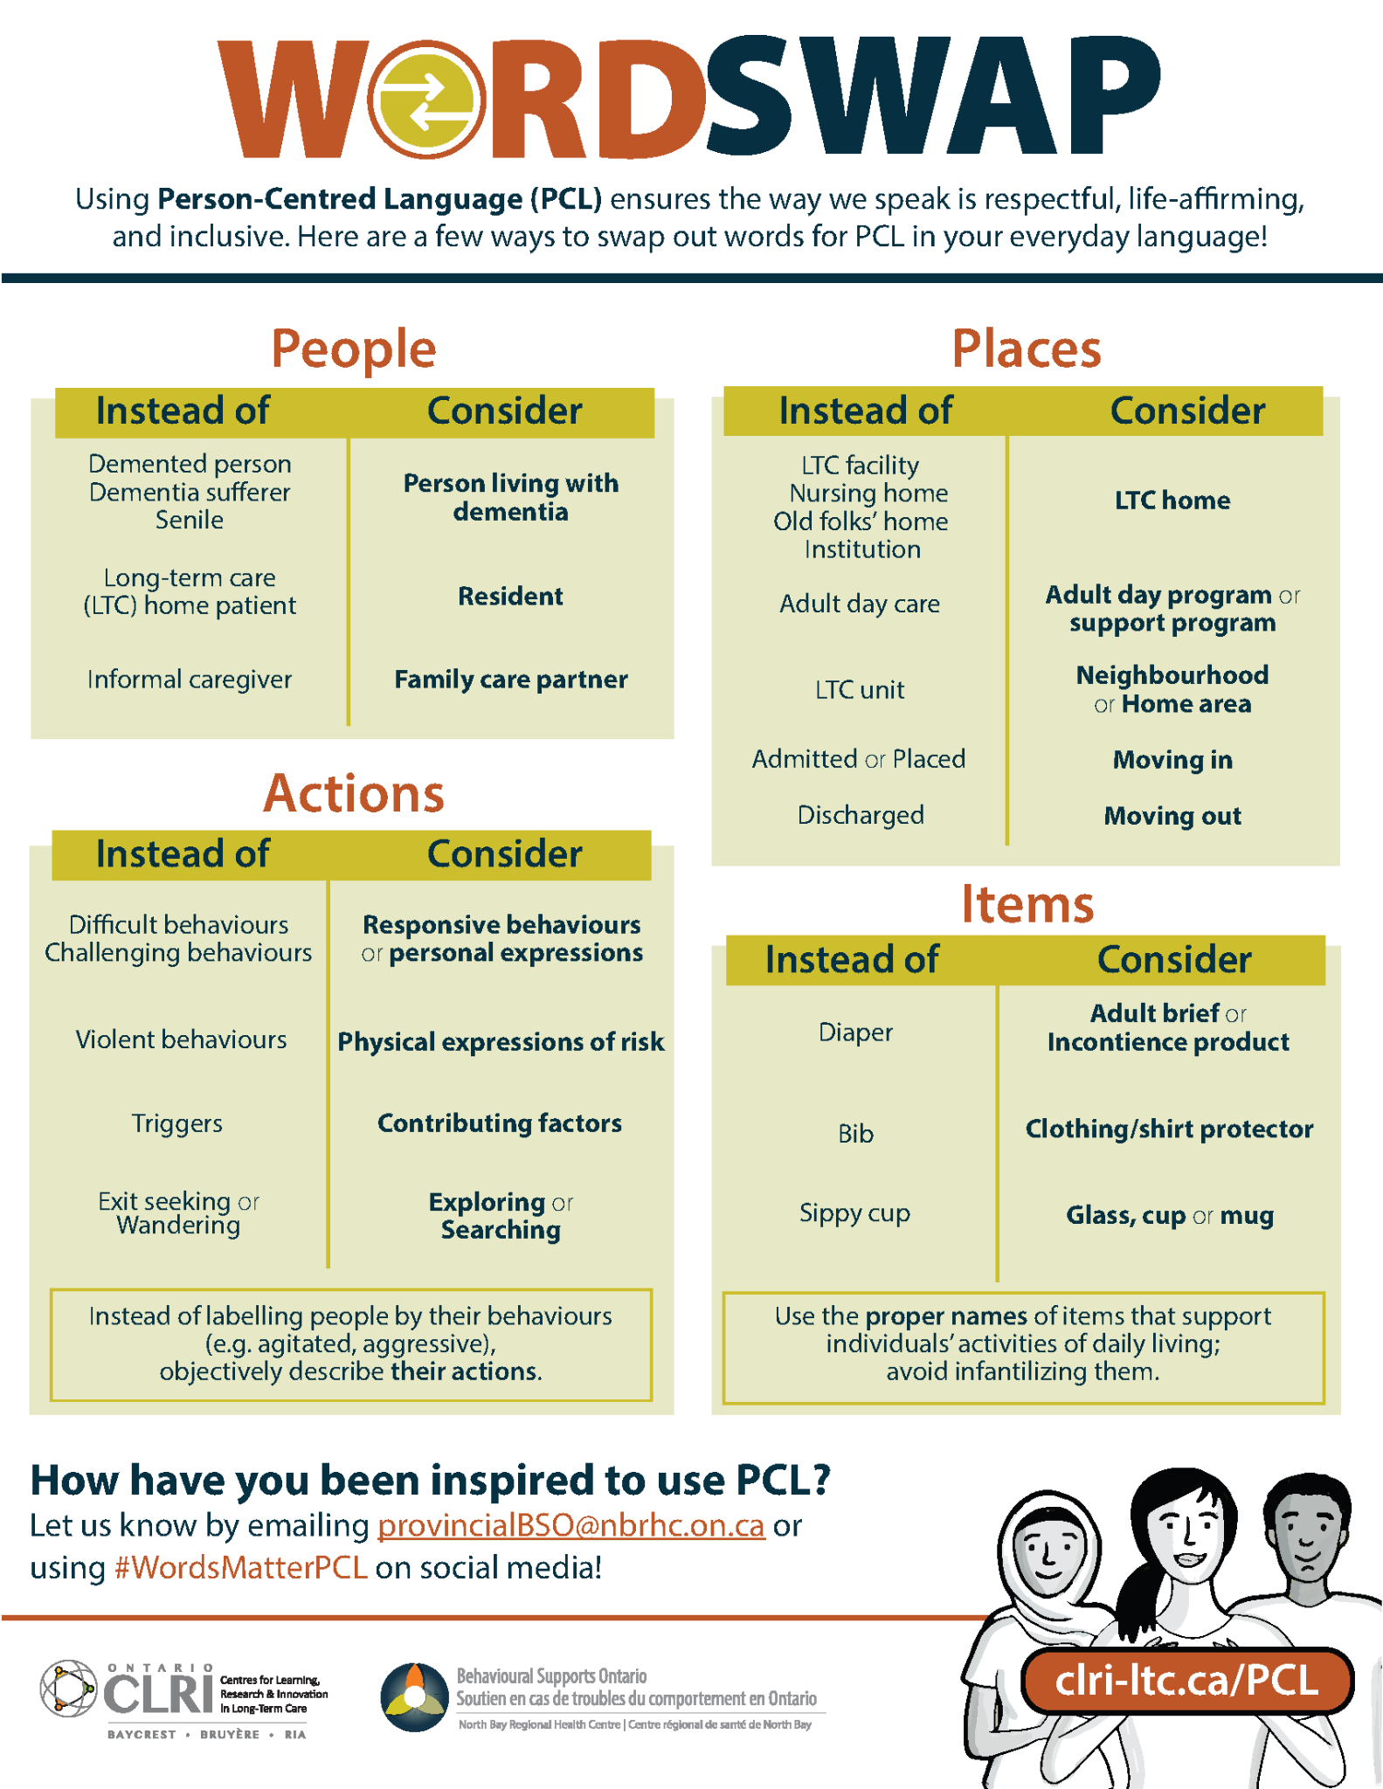
Word Swap
Consider swapping out common words in favour of person-centred language(PCL) in everyday conversations
French and English
Examples under four categories: people, places, actions, and items
Reflect on the power of words when supporting people with, or at risk, of responsive behaviours/personal expressions

Slide 13
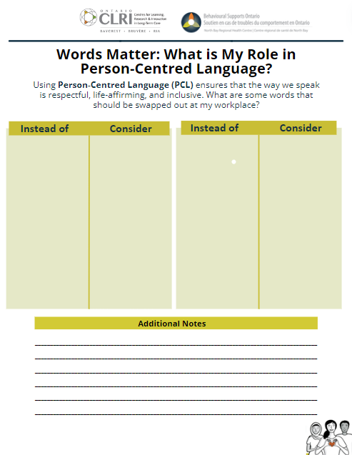
Create Your Own Word Swap
List other words that you have heard/seen and come up with ideas of preferred language to consider

Slide 14
Group Activity
How do you implement or encourage the use of PCL?

Slide 15
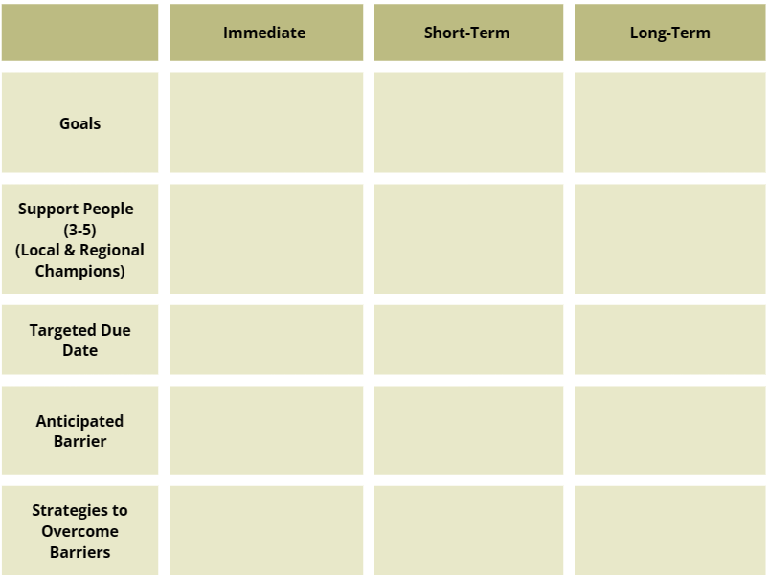
PCL Implementation Plan Worksheet

Slide 16




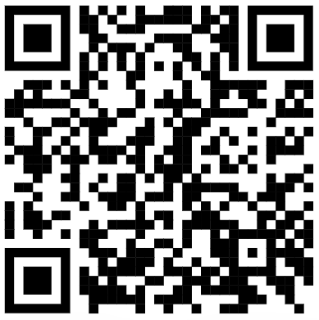



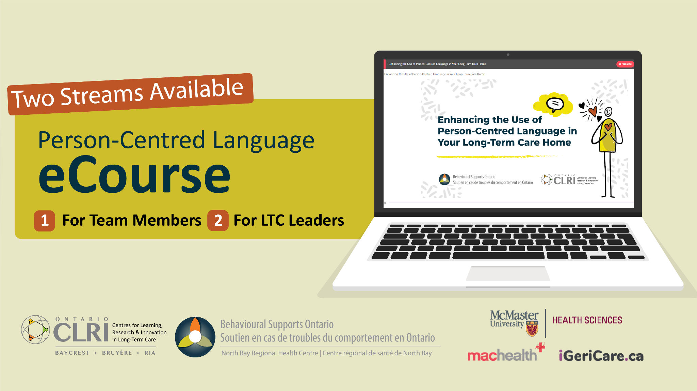
QR Code of webpage with all of the resources

Slide 17


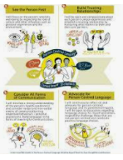


Immediate Implementation Strategies
Request large Commitment Statements Posters and display them.
Complete, print, and display your pledge certificate proudly on your door or in your office.
Print and display the Word Swap Poster in your entrance and/or elevator(s).

Slide 18




Short-Term Implementation Strateies
Share the PCL products with your Residents’ and Family Council and collaborate with them on their implementation.
Print and display the Word Swap Poster on your huddle board and/or nursing station with a blank page beside it. Invite team members to add their examples.
Host a 15-minute workshop about PCL during which team members take the pledge.

Slide 19



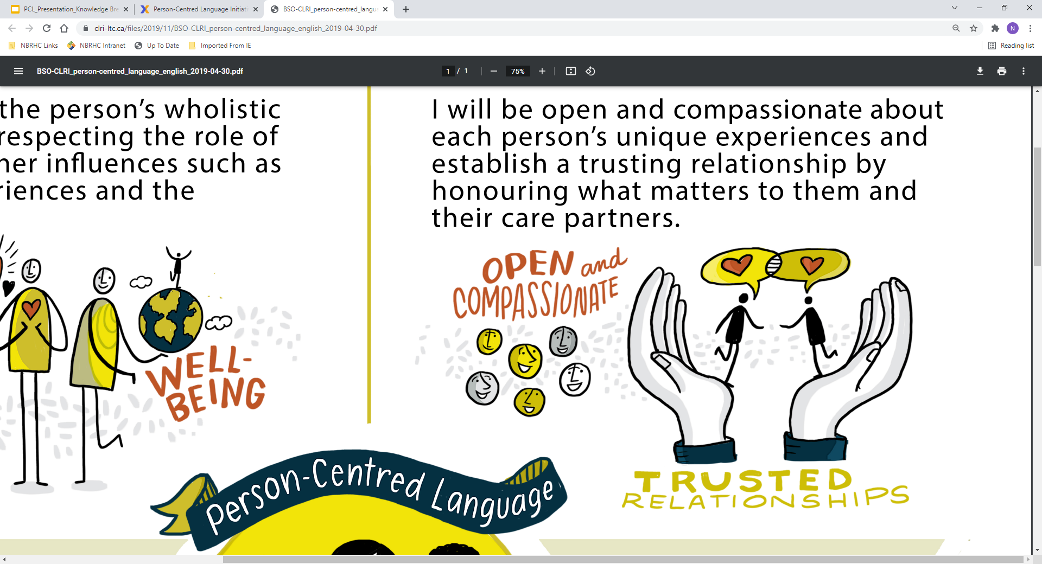
Short-Term Implementation Strategies
Announce your commitment to PCL on social media and challenge another LTC Home/ organization in your region to do the same.
Practice ‘calling people in’ by challenging the language choices of your close friends and family.
Create and display a ‘Word Swap of the Month’ Calendar for 2024.

Slide 20


Long-Term Implementation Strategies
Include the PCL eCourse in our mandatory orientation for new team members.
Consider updating the language in your mission/ value statement and policies.
Add the PCL eCourse to the list of assets on your job postings.

Slide 21
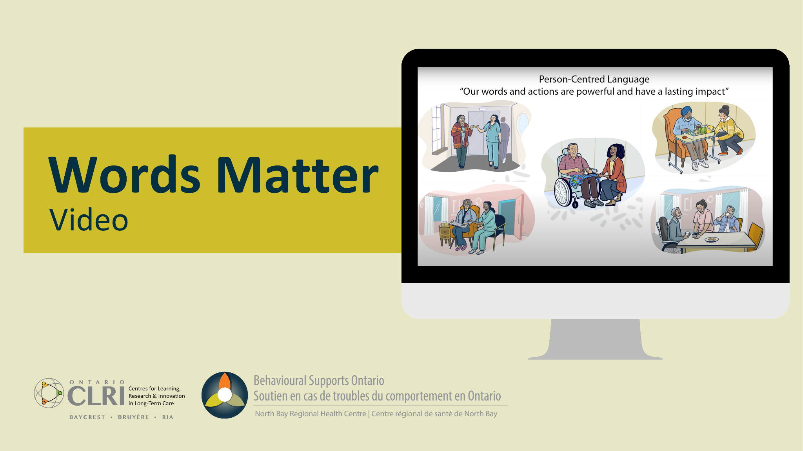

NEW! Resources
Calling In
Video

Slide 22

Closing Remarks
Find your ‘WHY’
Build your community
Explore Resources
Establish goals & timelines
CELEBRATE the small wins!

Slide 23
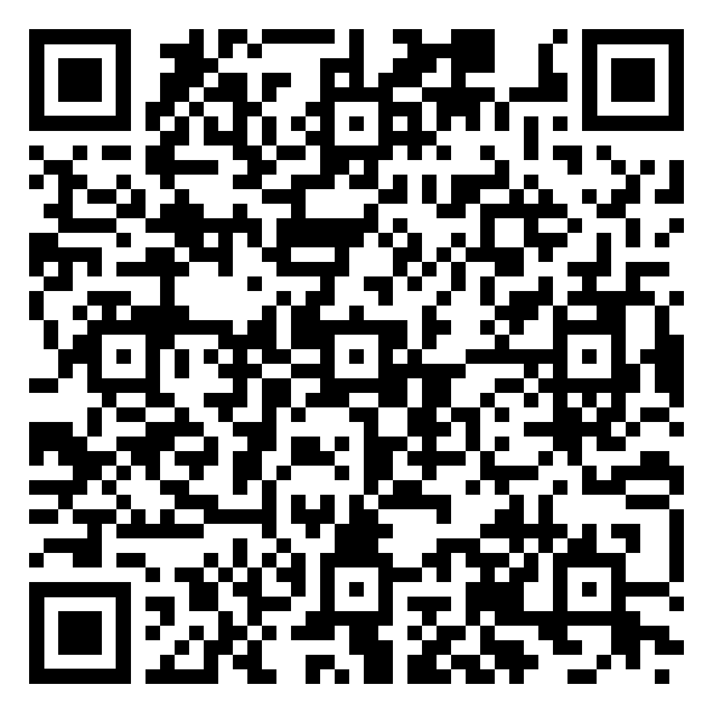

THANK YOU!
QUESTIONS?
For more information on the content of this workshop please contact:
PCL Resources Request Form
provincialBSO@nbrhc.on.ca

Slide 24

Take the Pledge!
Take the pledge to commit to using person-centred language in your daily interactions with those who live, work in and visit your care setting.
May 2024

